Slide 1
Ethereum
Introduction to
Developement in Ethereum

Slide 2
What is ethereum
Opensource public decentralized applications
Second biggest crypto currency
Ethereum does to apps what bitcoin did to money
Ethereum is programable block chain. Blockchain can be used for multiple applications. Thus, one common platform is ethereum.
Based on currency ether.
Introduced Smart Contract and Decentralized Autonomus Orgaizations.
Promotes Peer to Peer application as opposed to trusted server based application.

Slide 3
Bitcoin vs Ethereum
 | Bitcoin | Ethereum
Concept | Digital Money | World Computer
Programable | No | Solidity scripting, Viper
Release Date | 2009 | 2015
Coin Release | Through early mining | Through ICO
Average Block Time | 10 minutes | 12-15 seconds
Currency | BTC | Ether
Statefulness | Lacks statefulness | Saves the state.

Slide 4
Smart Contract
Immutable piece of code.
Contract lasts for ever till Ethereum exists.
Similar to ATM.
Similar to Webservice and Spring Service(without dao).
Similar to Programable bank account.
Solidity most popular programing language.

Slide 5
Decentralized Autonomus Organizations(DAO)
DAOs exists completely in blockchain.
Multiple Smart Contracts.

Slide 6
Wallets for Ethereum
Wallets maintains encrypted private key.
Creates a signed transaction ie. encrypt the message with the private key.
Wallet is primary user interface and controls access to accounts money.
Manages multiple keys and addresses and gets balances for them from blockchain.
Wallet dont contain ether or coin.
Types of wallets available
Browser extension-Metamask
New Browser-Mist
Hardware wallets-Ledger Nano,Tenzor.

Slide 7
Gas Price in Ethereum
Gas is required to be paid for every operation.
A transaction fee chaged from transaction originator account.
Its a execution fee for code execution.
High transaction fee may increase probability of completing transaction at faster speed.
If origination doesnt have enough ether, all changes from transaction are rolledback. Fees still goes to miner.
Operation | Gas Cost | Desc
step | 1 | Default amount per execution cycle
stop | 0 | Free
sucide | 0 | Free
sha3 | 20 | SHA-3 hash function
sload | 20 | Gets from permanent storage
sstore | 100 | Puts into permanent storage
create | 100 | Contract creation
call | 20 | Initiating a read-only call
Memory | 1 | Every additional word when expanding memory
txdata | 5 | Every byte of data or code for transaction
transaction | 500 | Base fee Transaction
contract creation | 53,000 | Create contract

Slide 8
Denomination of ether
Unit | Wei Value | Number of Wei
Wei | 1 wei | 1
Kwei | 1 ^ 3 wei | 1,000
Mewi | 1 ^ 6 wei | 1,000,000
Gwei | 1 ^ 9 wei | 1,000,000,000
Microerthe | 1 ^ 12 wei | 1,000,000,000,000
Miliether | 1 ^ 15 wei | 1,000,000,000,000,000
Ether | 1 ^ 18 wei | 1,000,000,000,000,000,000

Slide 9
Types of Accounts
External Accounts- Public key.
Smart Contracts

Slide 10
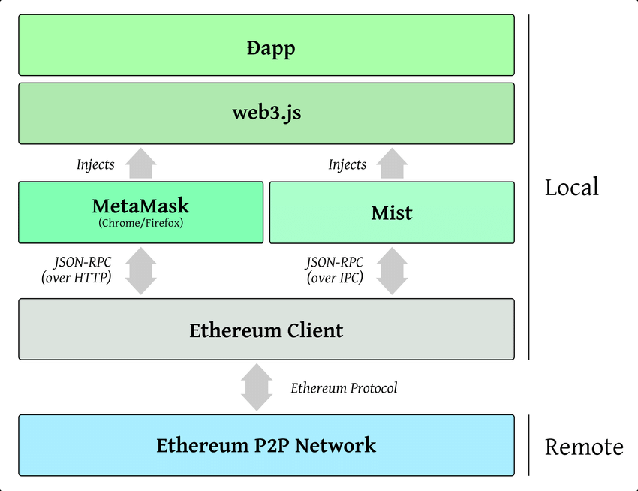
Developement tools
Node JS - WebServer
Truffle – compile and deploy the contracts
Ganache – Ethereum Simulator
Metamask – Wallet
Web3.js – Javascript library

Slide 11
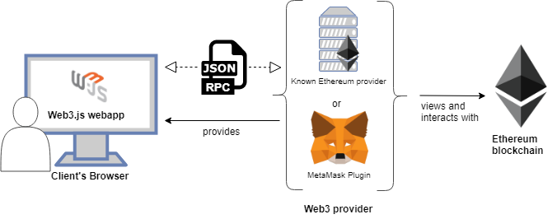
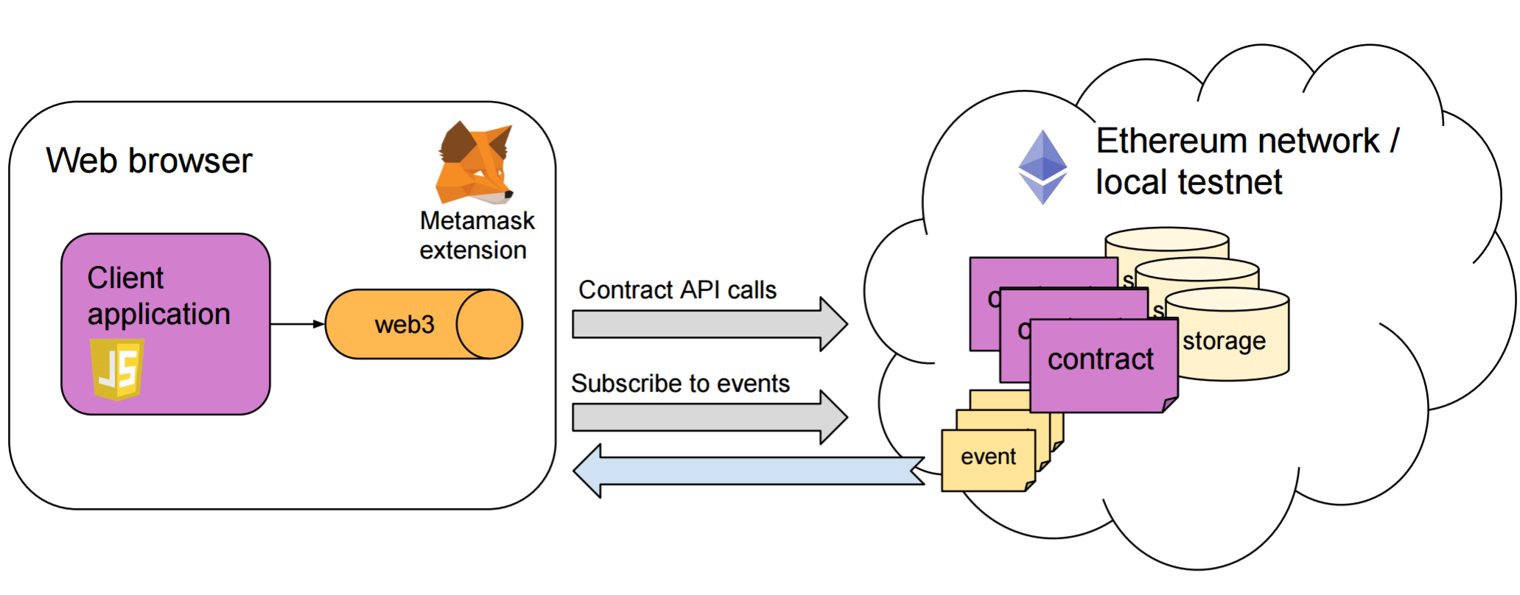
Dapp Architecture
Dapp is a GUI application that uses Ethereum Smart contract on backend, as opposed to conventional database and web application hosting provider.

Slide 12
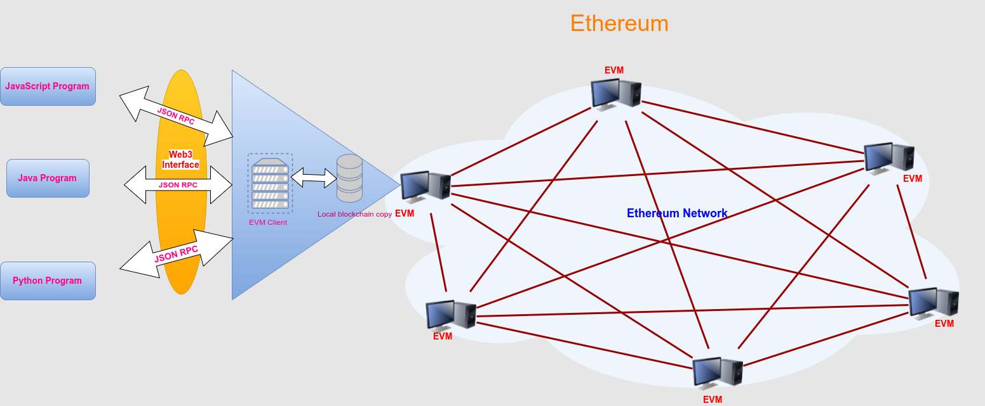
Web3.js Javascript Library
Dapps use web3 liabrary that talks to ethereum blockchain.
Web1 was read only static pages, Web2 is read-write data.
Web3 aims unmediated read-write.
Users control data privacy and ownership.
Rent-seeking third parties have less control over user interaction and value transfers.
Web3 technologies provide the foundation for P2P (peer-to-peer) communication, payments, services, and marketplaces.

Slide 13
Uses of Ethereum
Crowd funding and financing.
Hedging and money market.
Gaming, Collectibles and lottery.
Marketplaces and exchanges.
Loyalty points.
Services to be called by Internet of Things.
Micro payments.
Brokerage and commission.
Charity.
Centralization to decentralization.

Slide 14
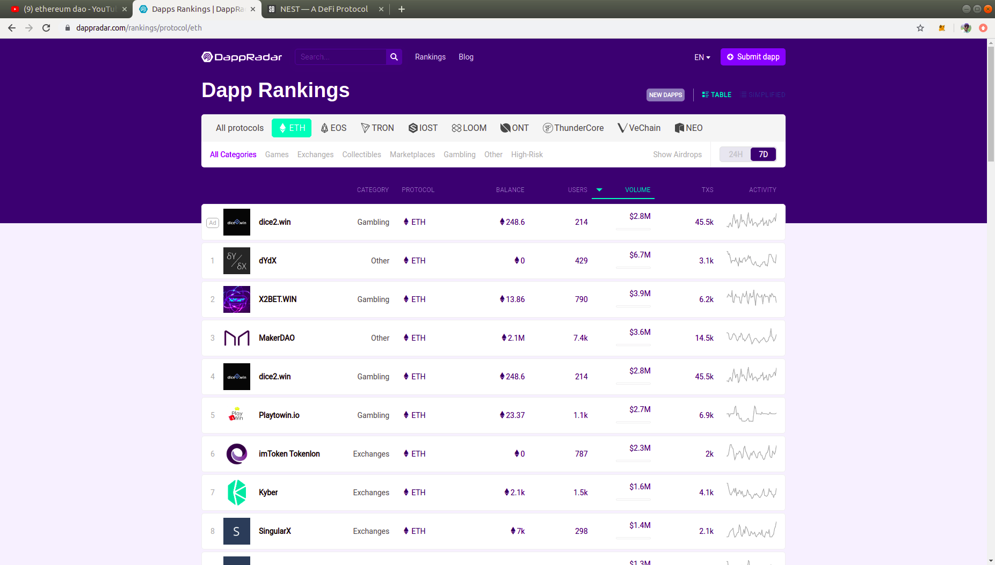
Dapps Radar

Slide 15
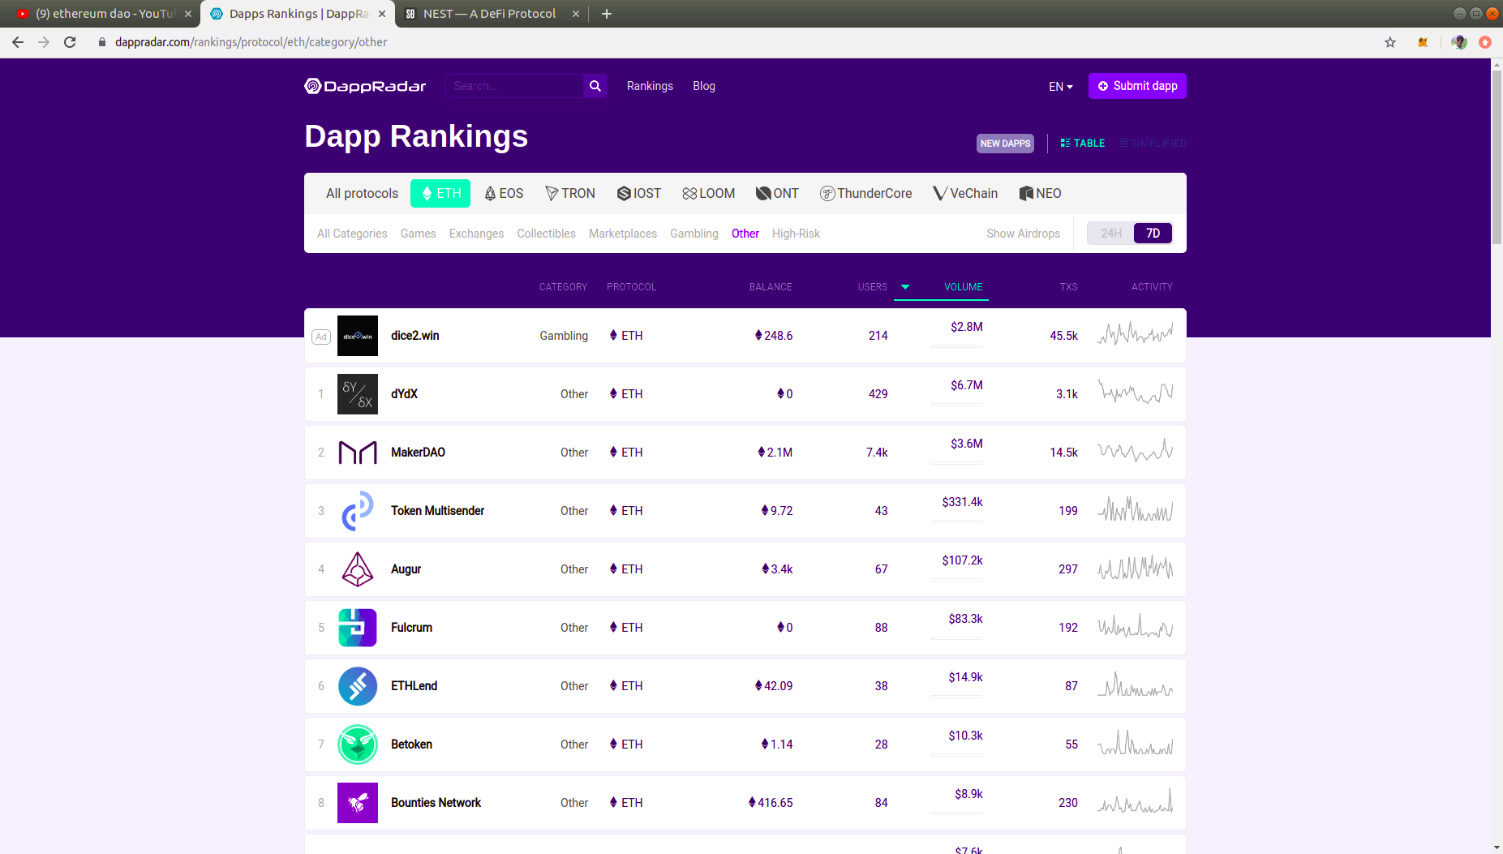
Dapps Radar

Slide 16
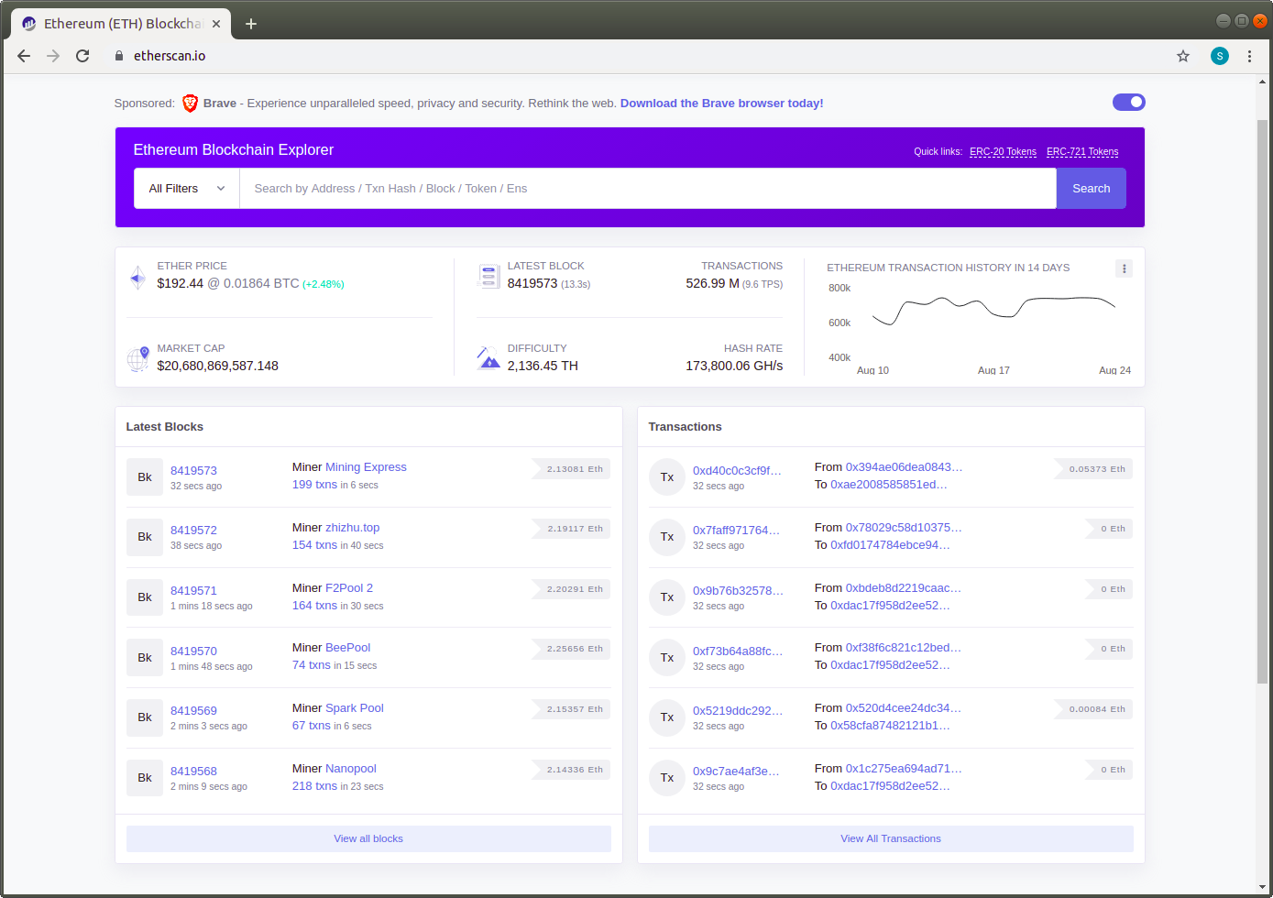
Etherscan

Slide 17
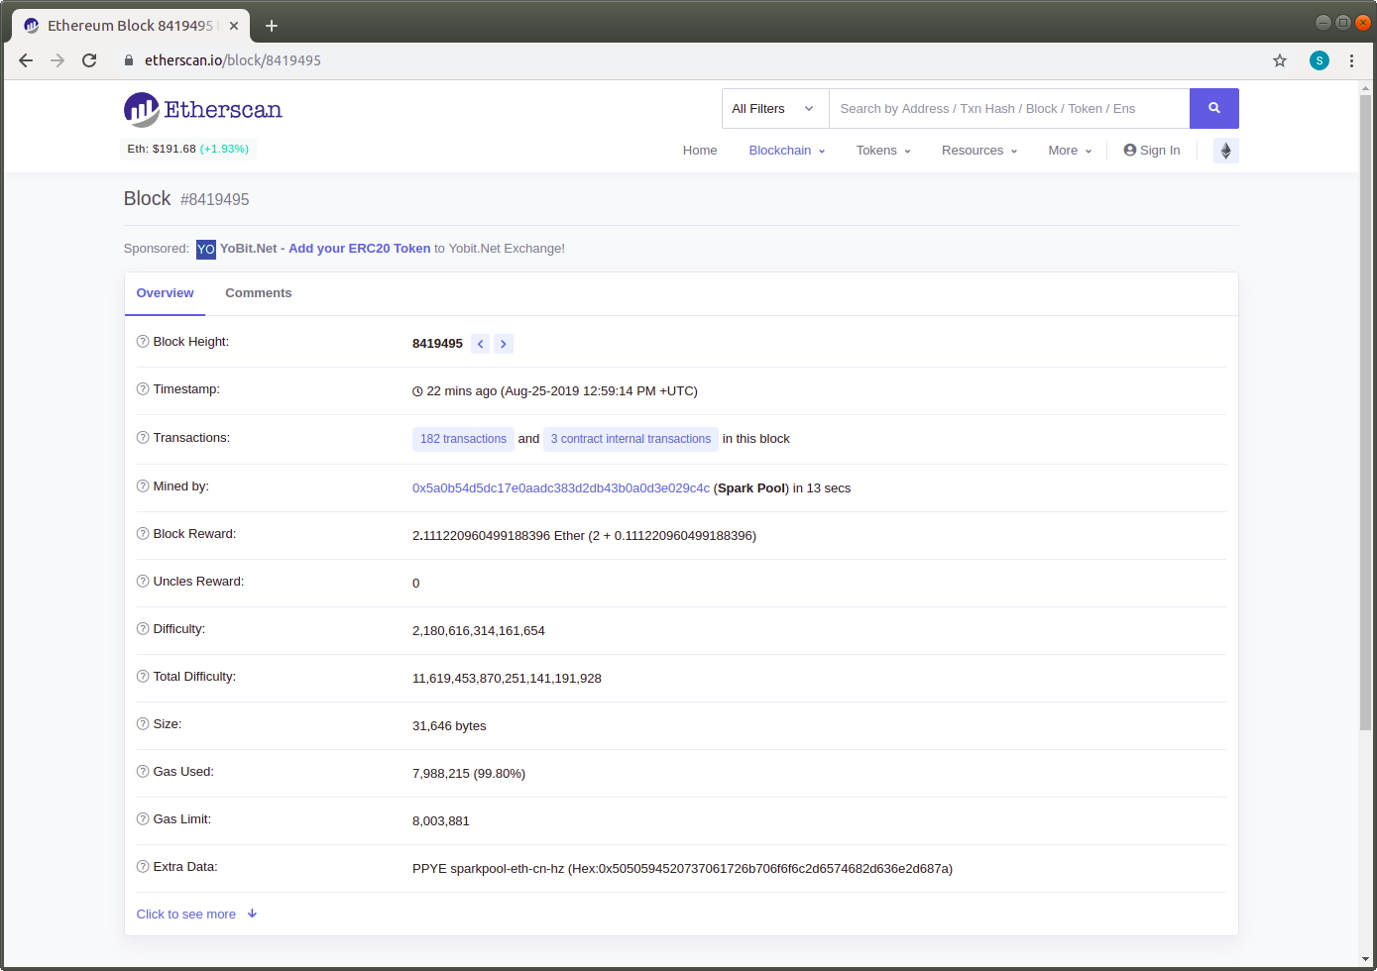
Etherscan

Slide 18
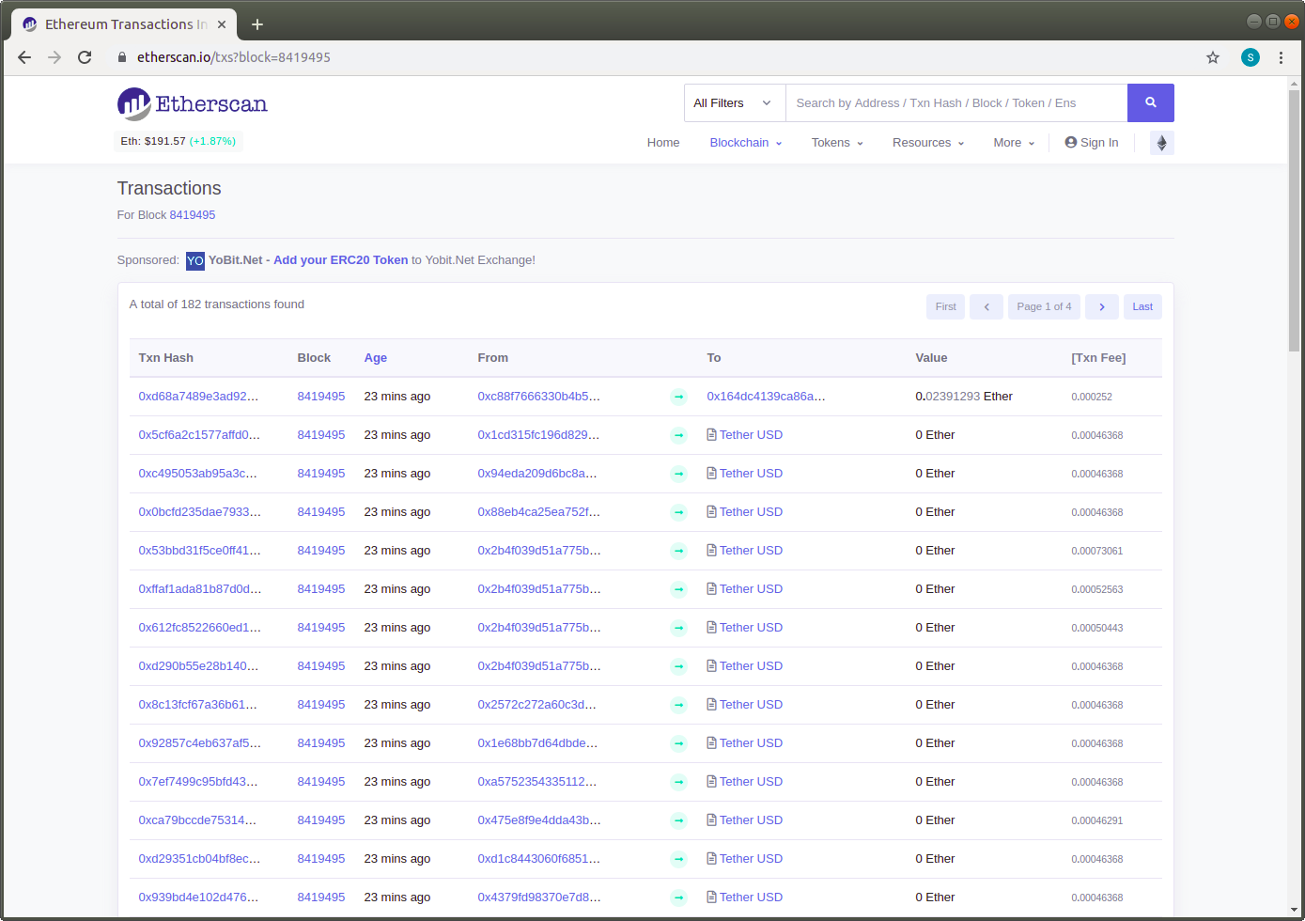
Etherscan

Slide 19
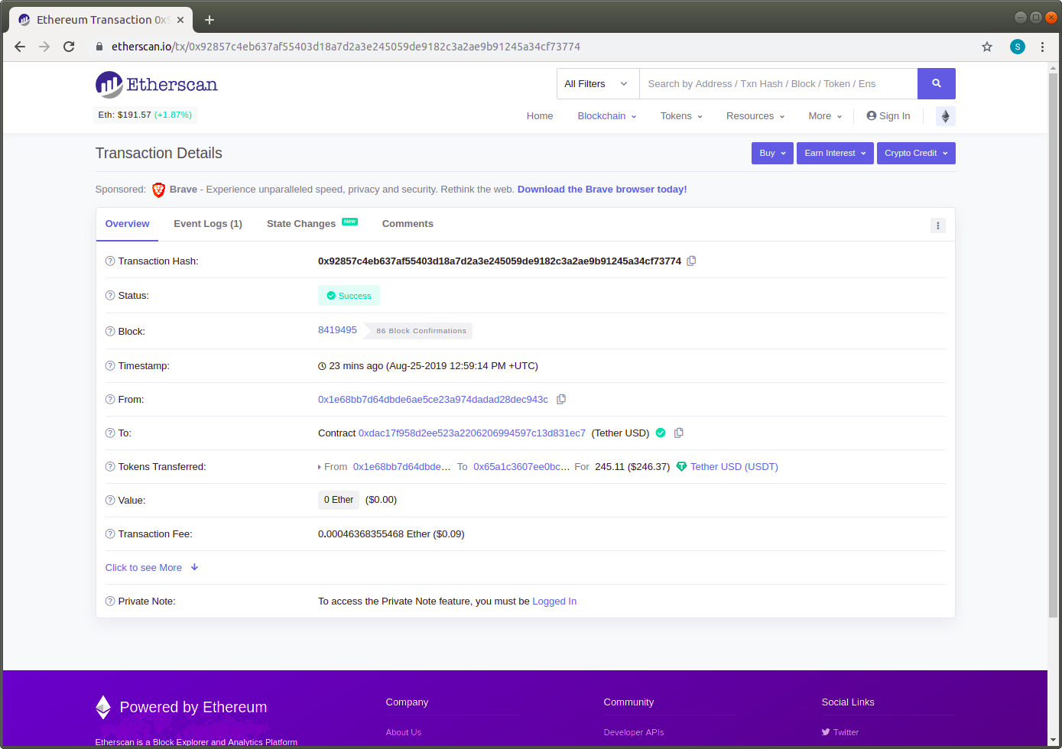
Etherscan

Slide 20
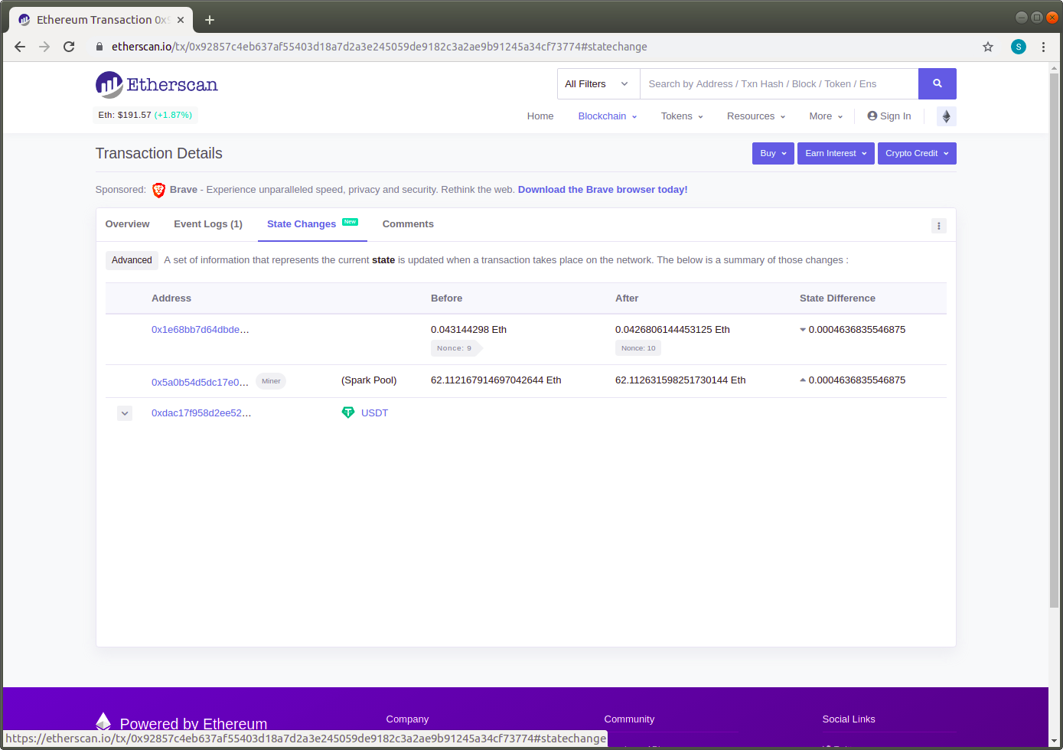
Etherscan

Slide 21
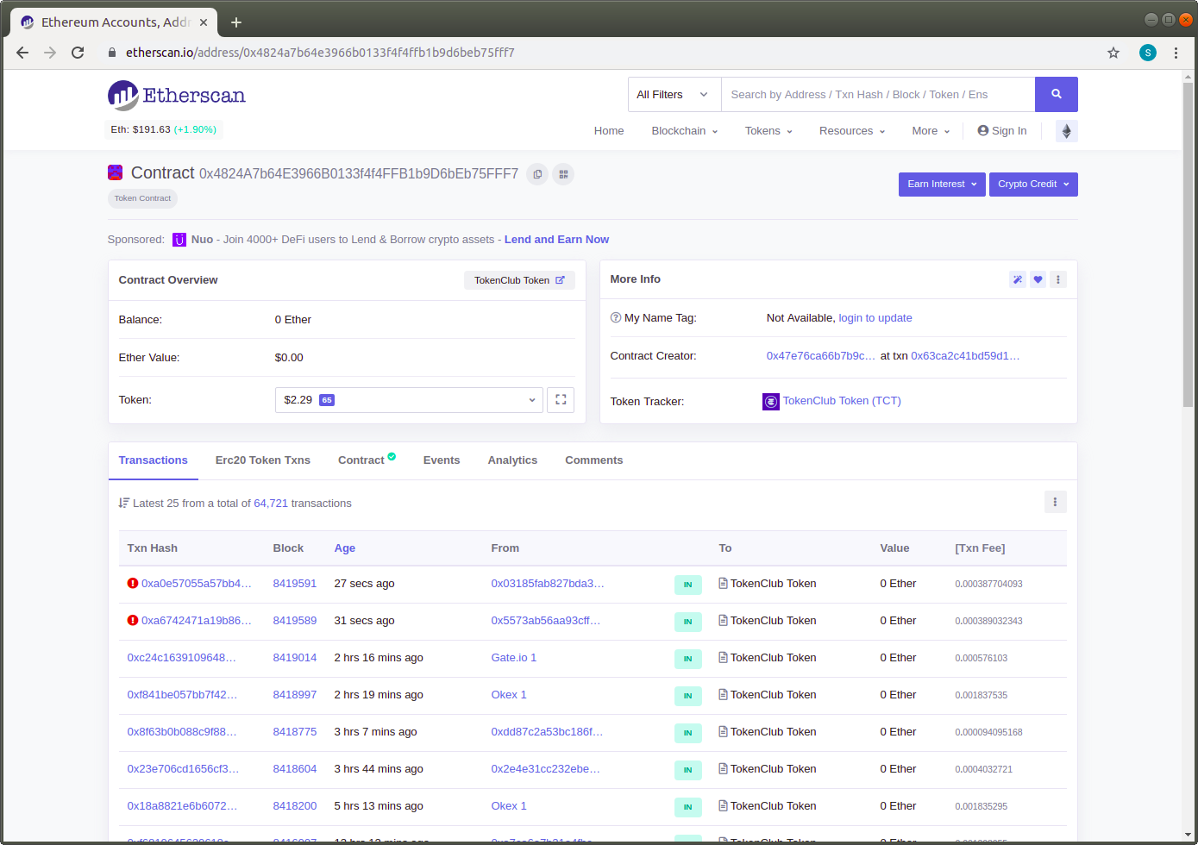
Etherscan

Slide 22
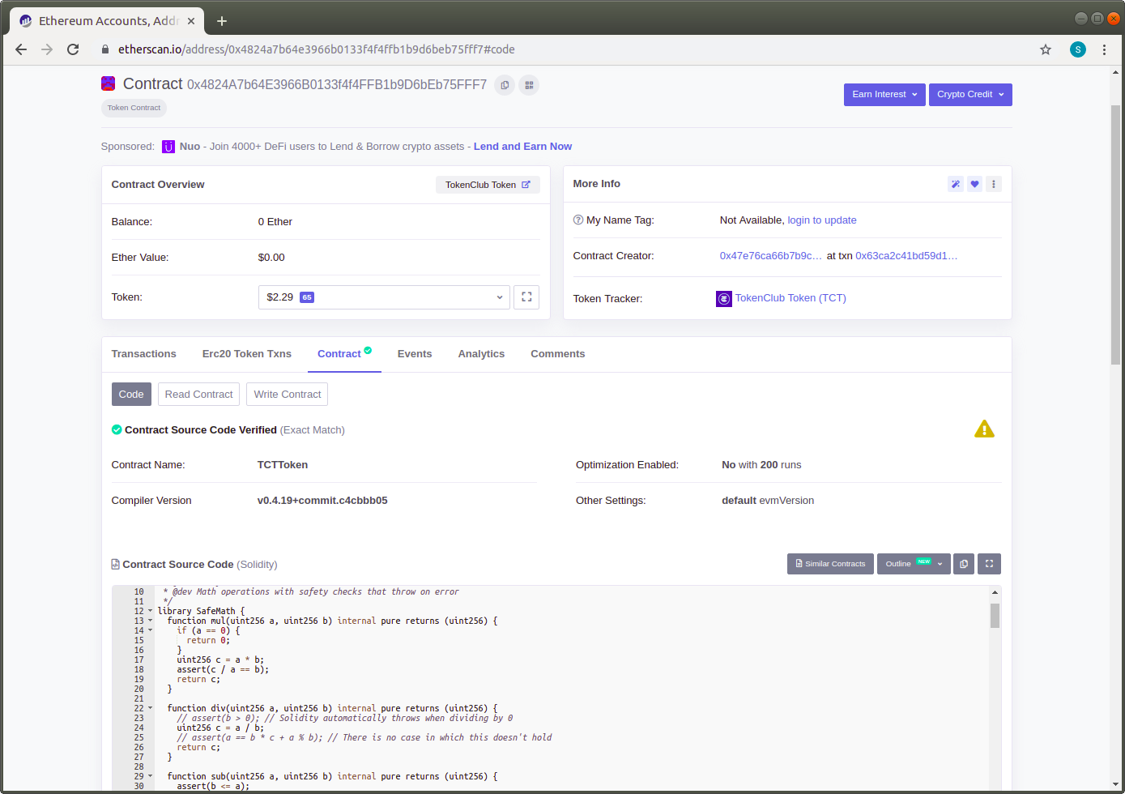
Etherscan

Slide 23
Remix IDE
Code, compile and test from browser.
Run on test networks or local test environment.
Allows us to call functions,getters and setters.
Allows us to transfer amount with accounts.

Slide 24
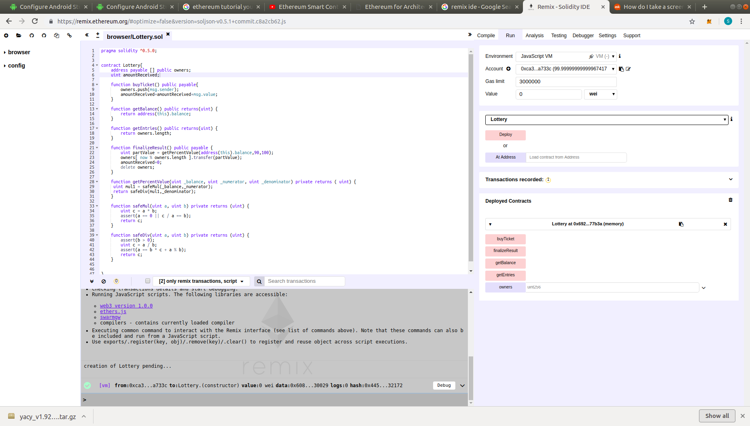
Remix IDE

Slide 25
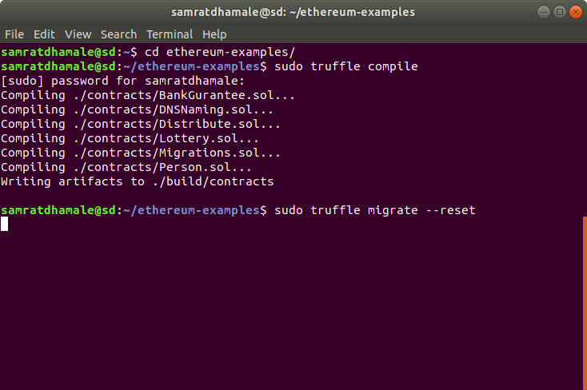
Compilation and Deployment of Contracts

Slide 26
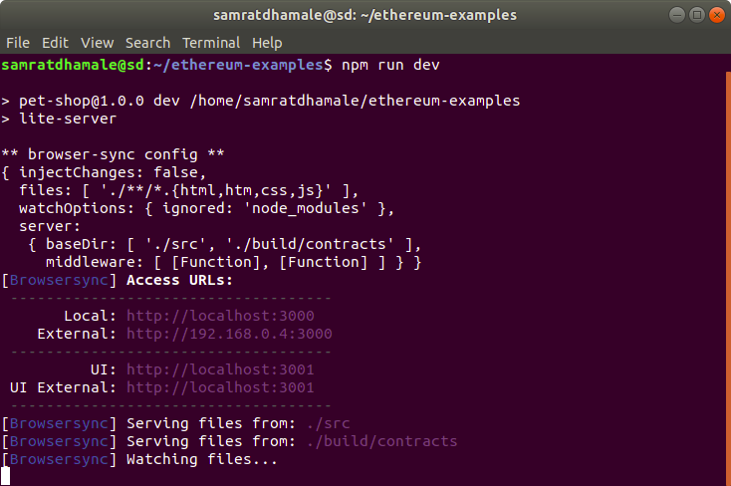
Starting npm webserver

Slide 27
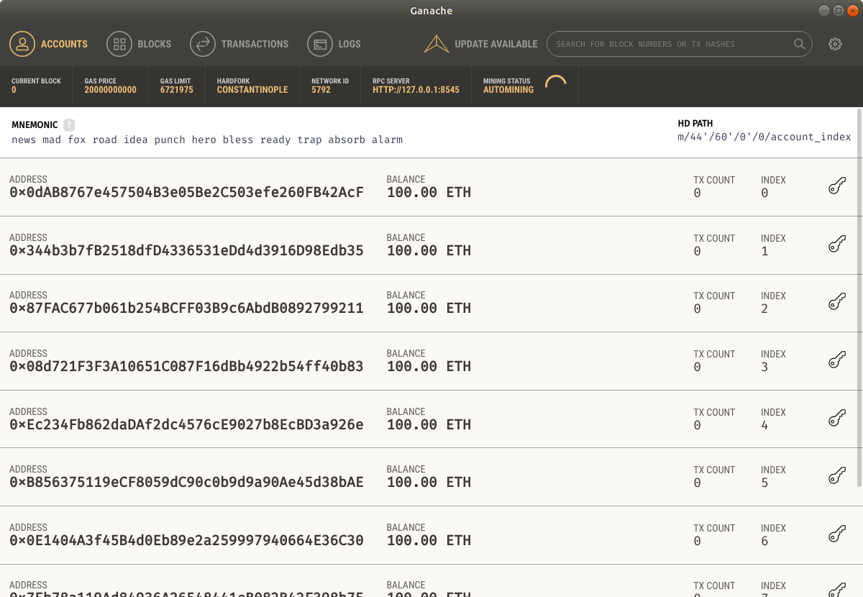
Starting Ganache

Slide 28
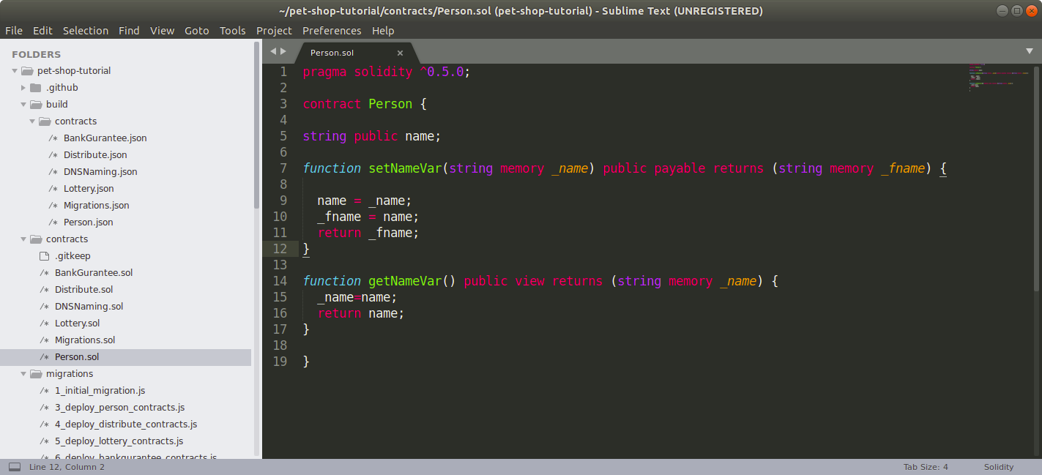
Simple Example-Smart Contract

Slide 29
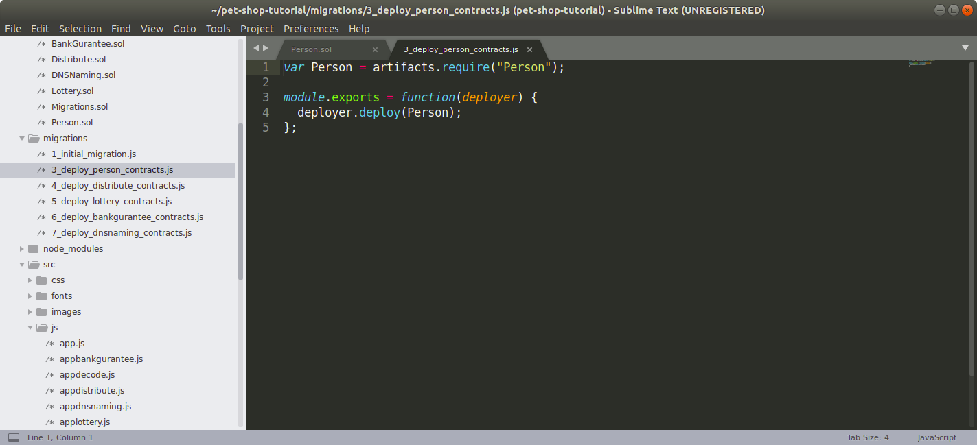
Simple Example-Deployment Script

Slide 30
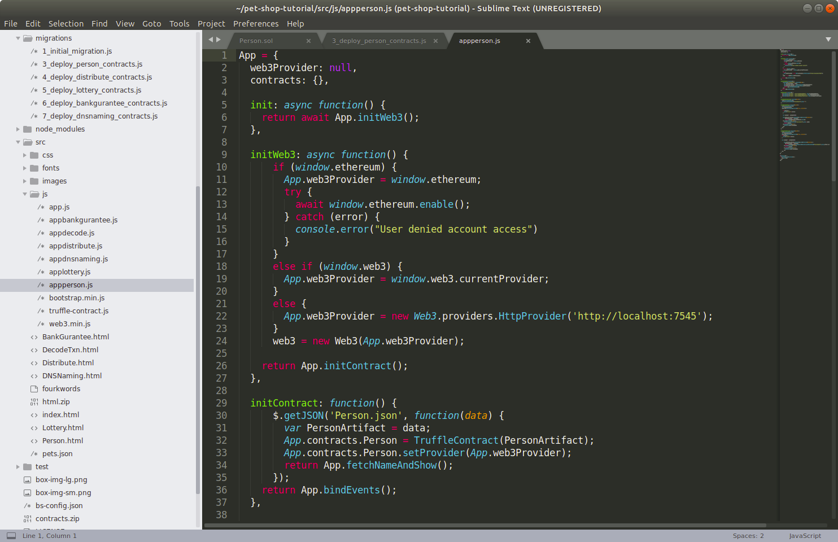
Simple Example-Javascript

Slide 31
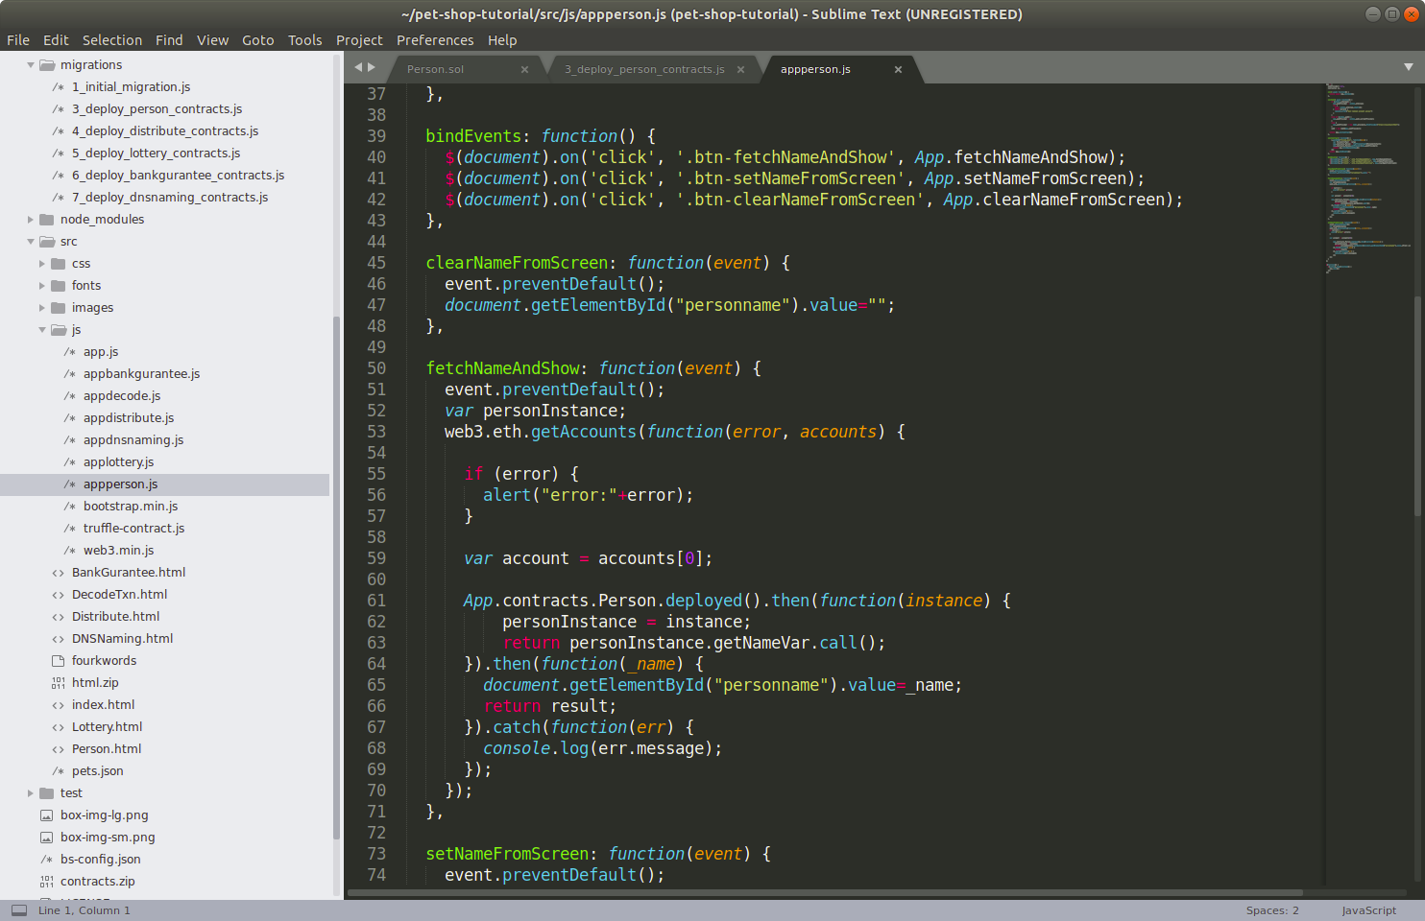
Simple Example-Javascript

Slide 32
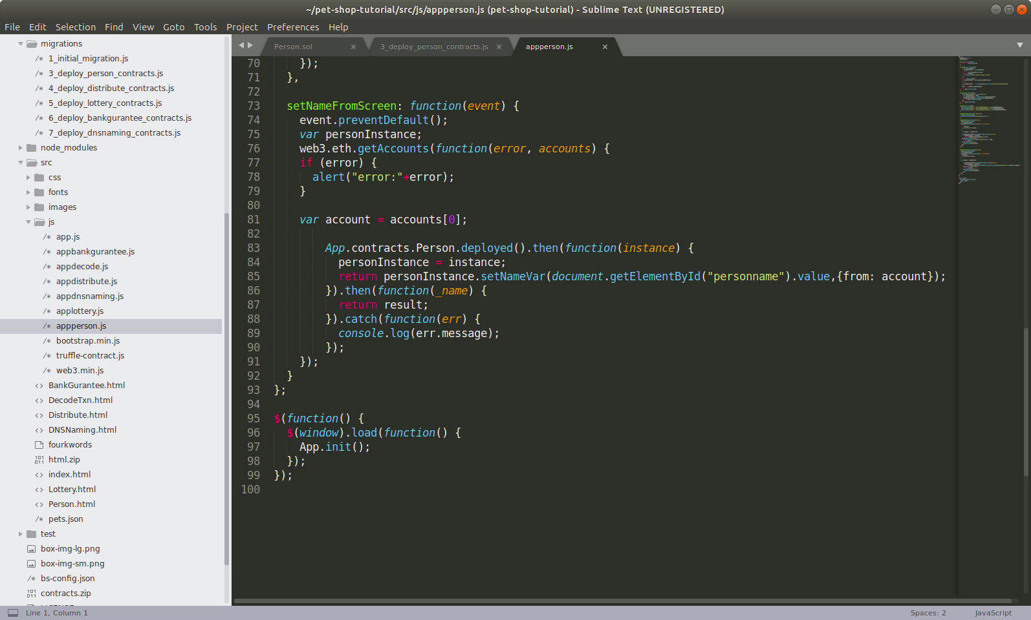
Simple Example-Javascript

Slide 33
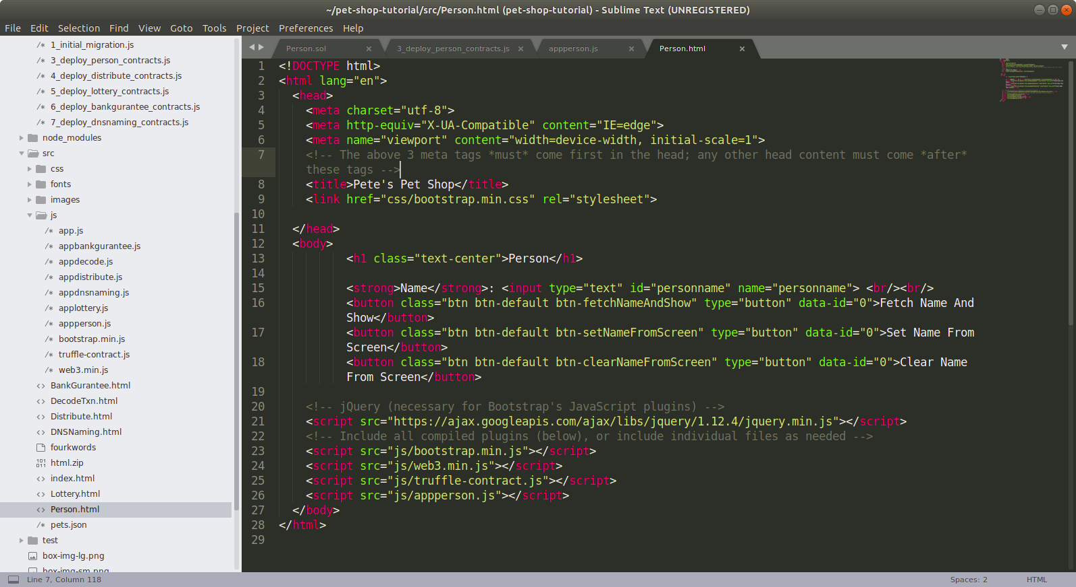
Simple Example-HTML

Slide 34
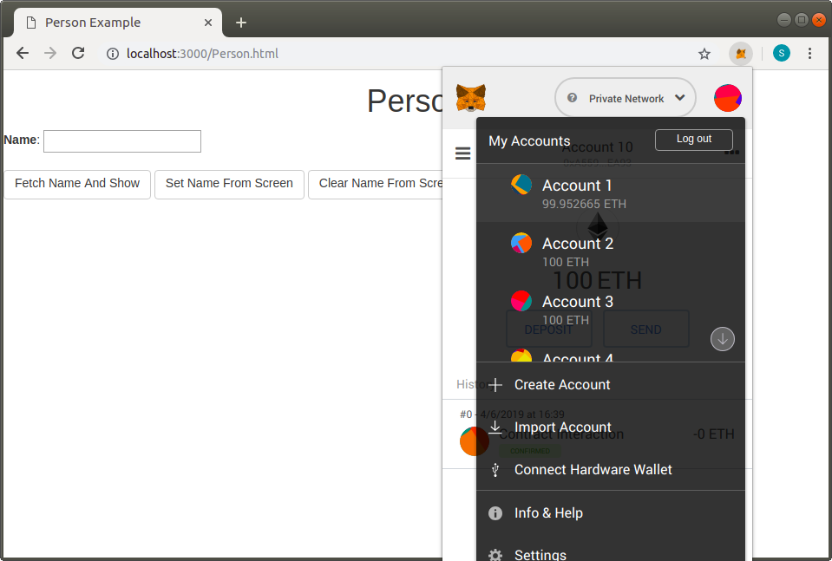
Simple Example-Open browser and Metamask login

Slide 35
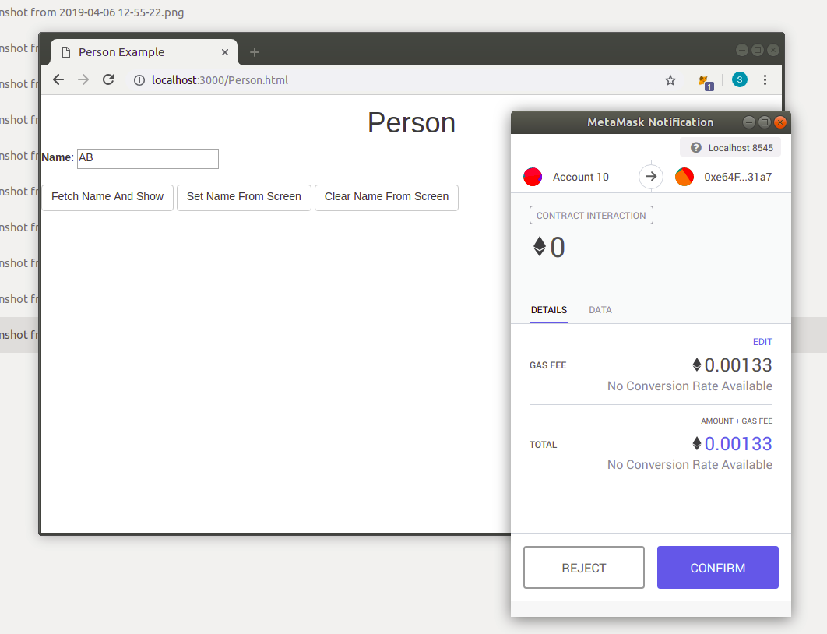
Simple Example-Setting name

Slide 36
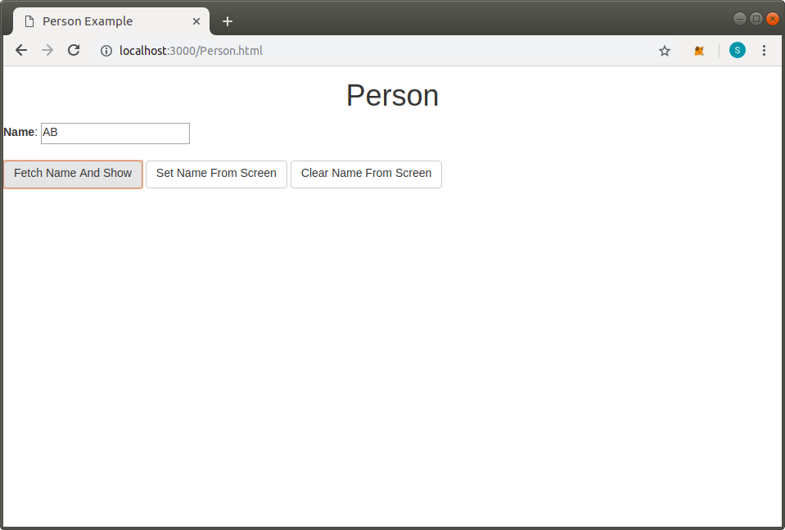
Simple Example-Fetch name

Slide 37
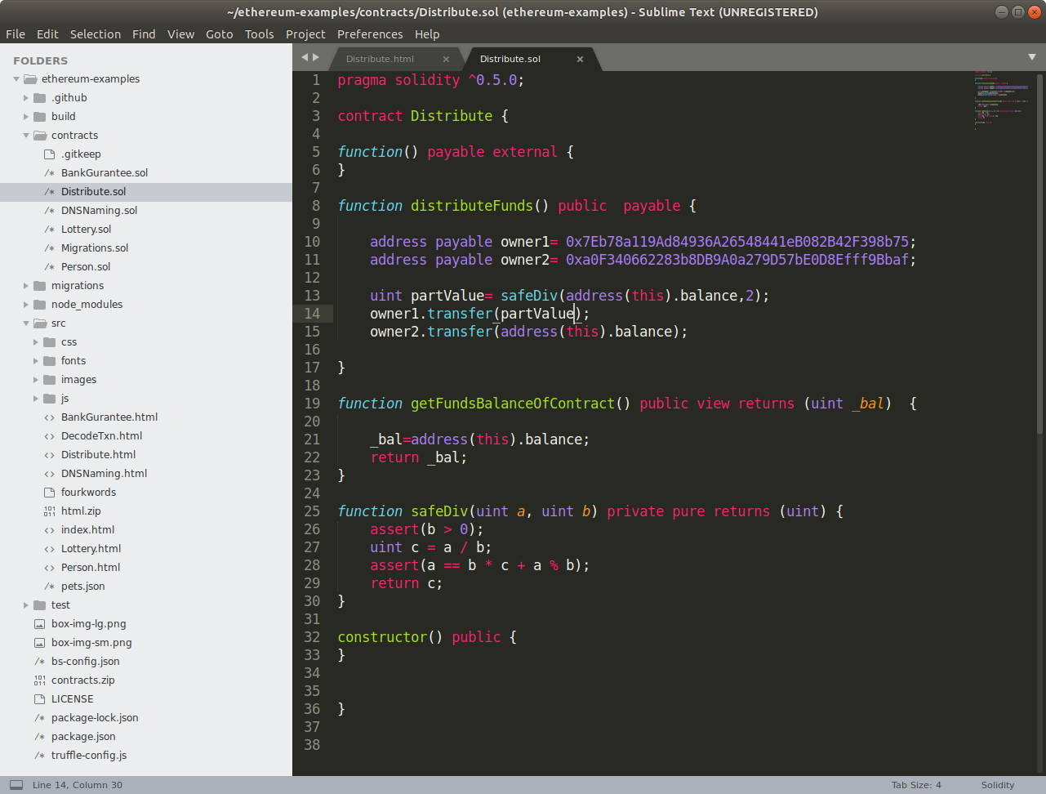
Distribute Example- Smart Contract

Slide 38
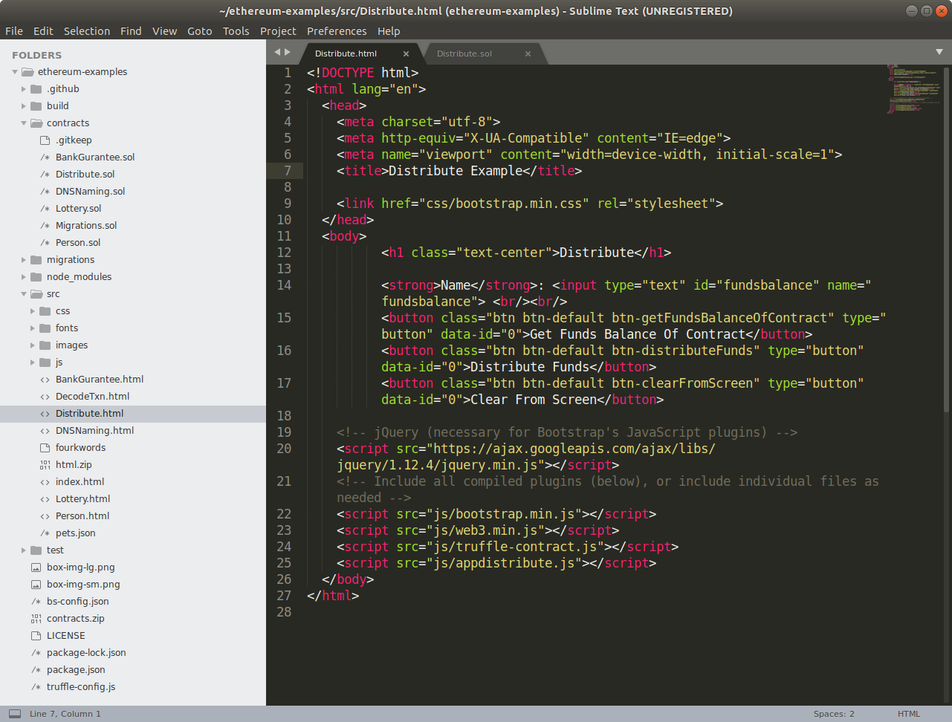
Distribute Example-HTML

Slide 39
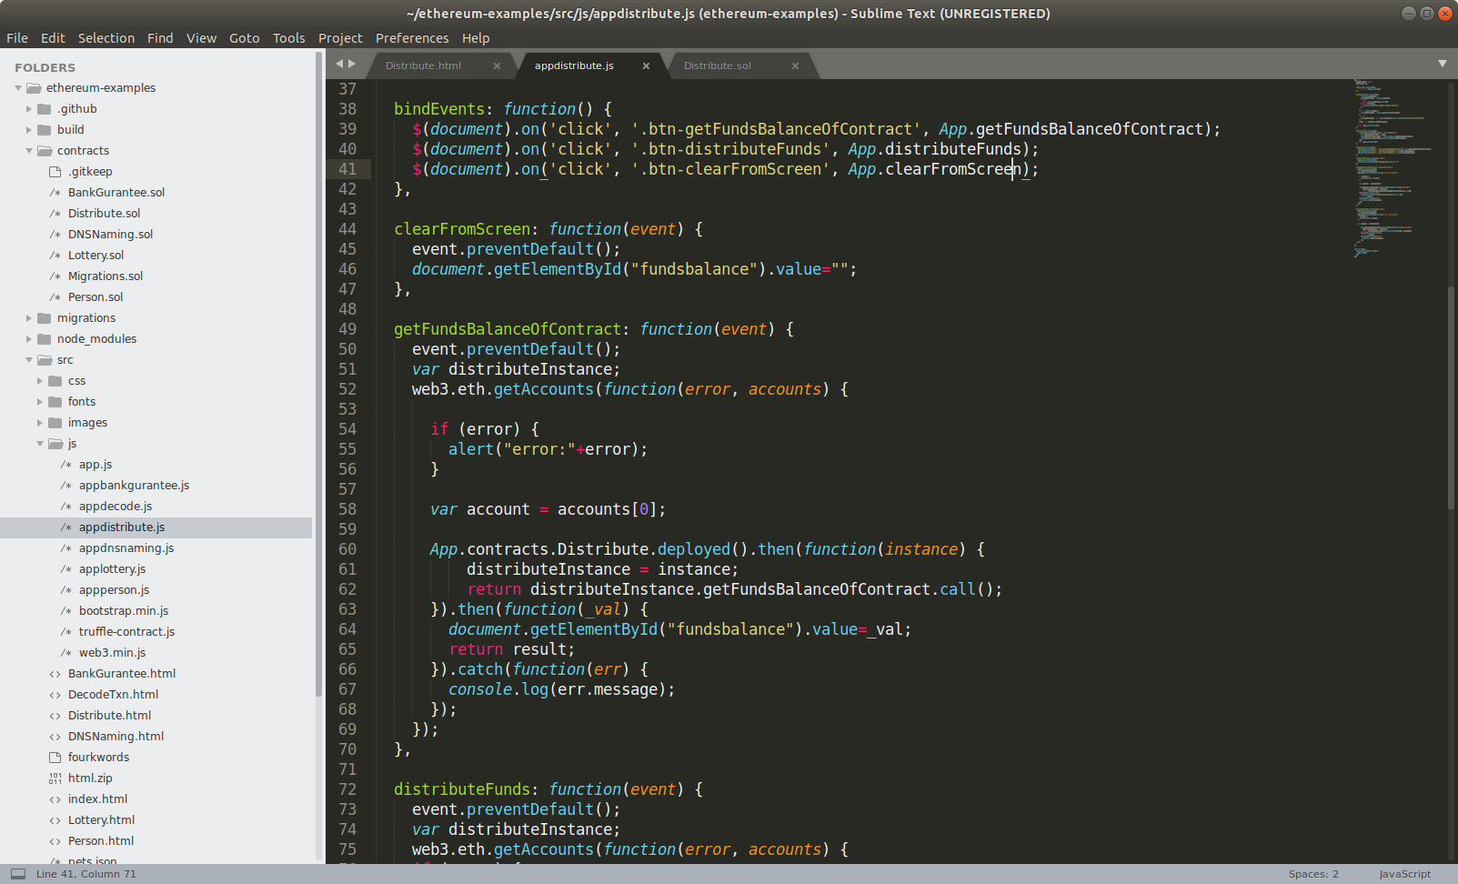
Distribute Example - Javascript

Slide 40
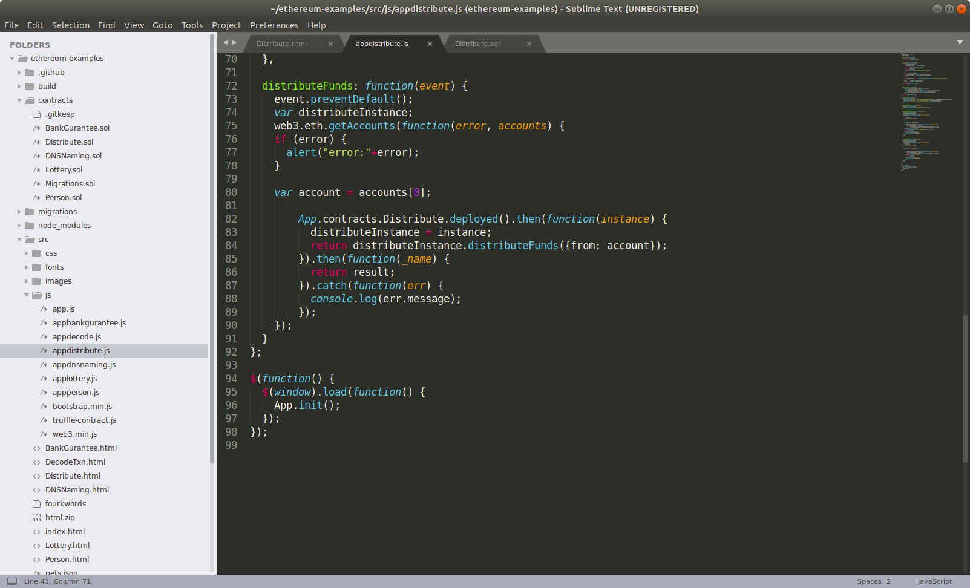
Distribute Example - Javascript

Slide 41
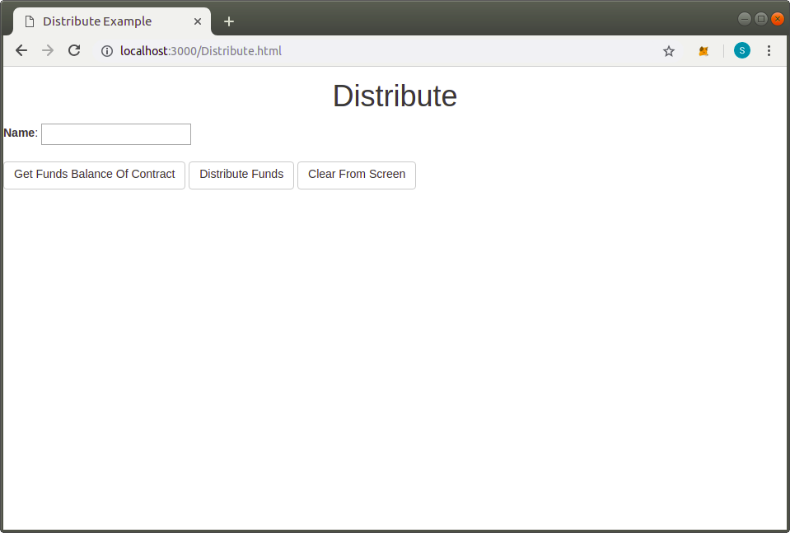
Distribute Example

Slide 42
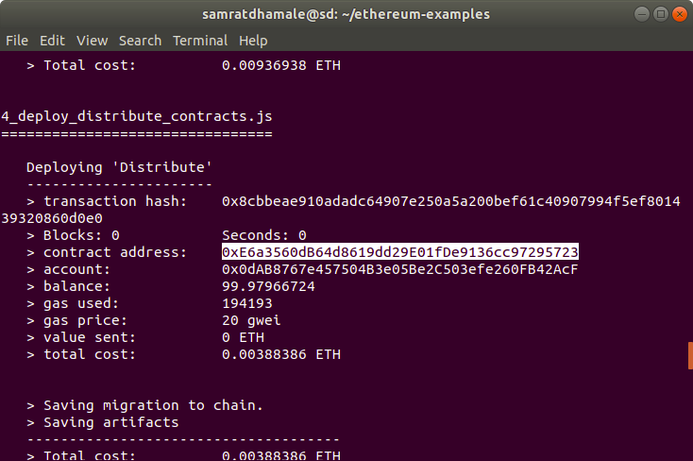
Distribute Example-Copy Contract Address

Slide 43
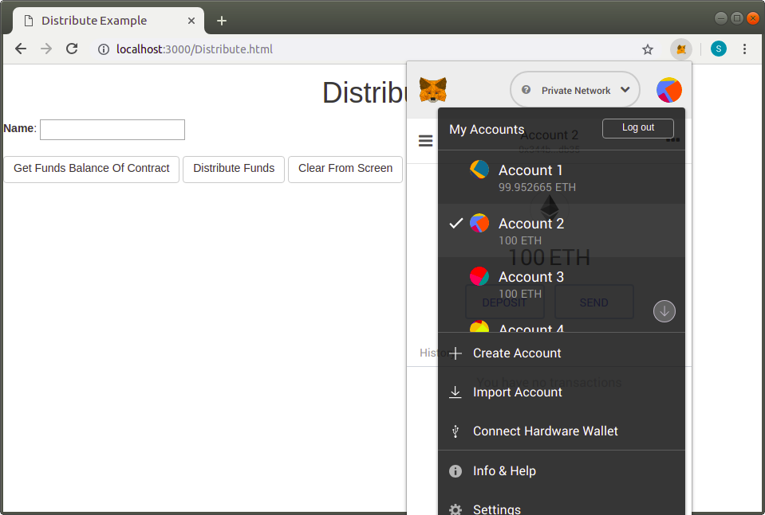
Distribute Example-Select Account

Slide 44
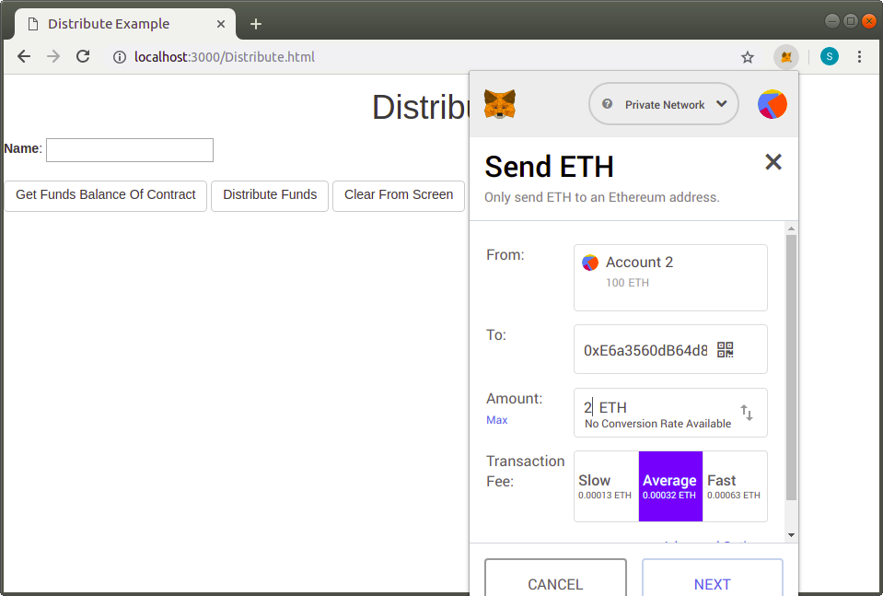
Distribute Example-Send ETH to contract

Slide 45
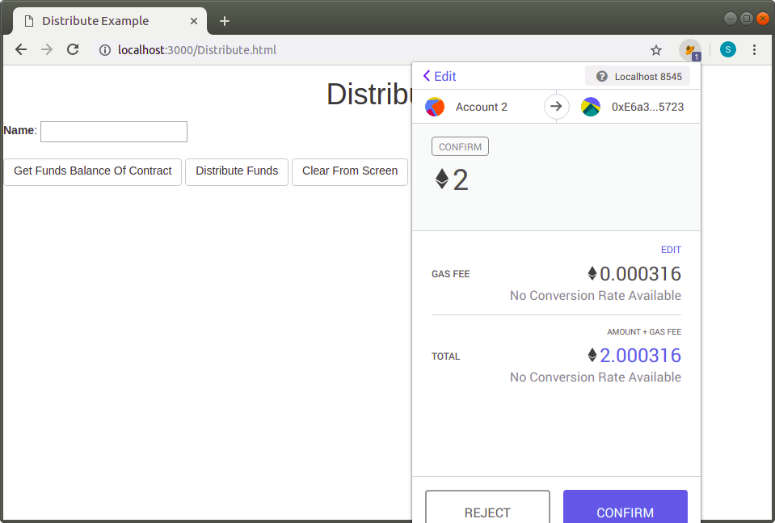
Distribute Example-Send ETH from other account

Slide 46

Distribute Example-Send ETH from other account

Slide 47
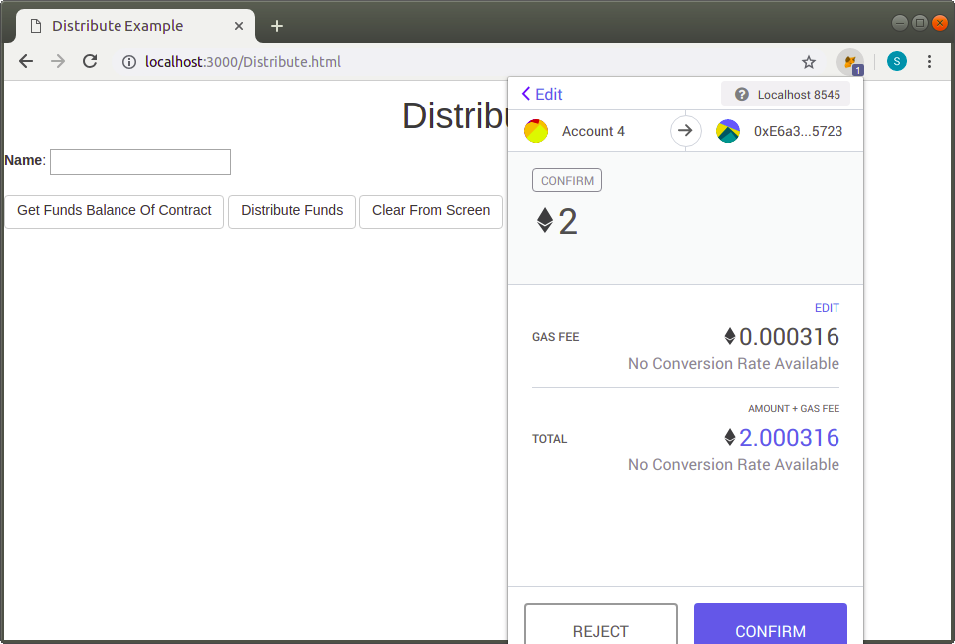
Distribute Example-Send ETH from other account

Slide 48
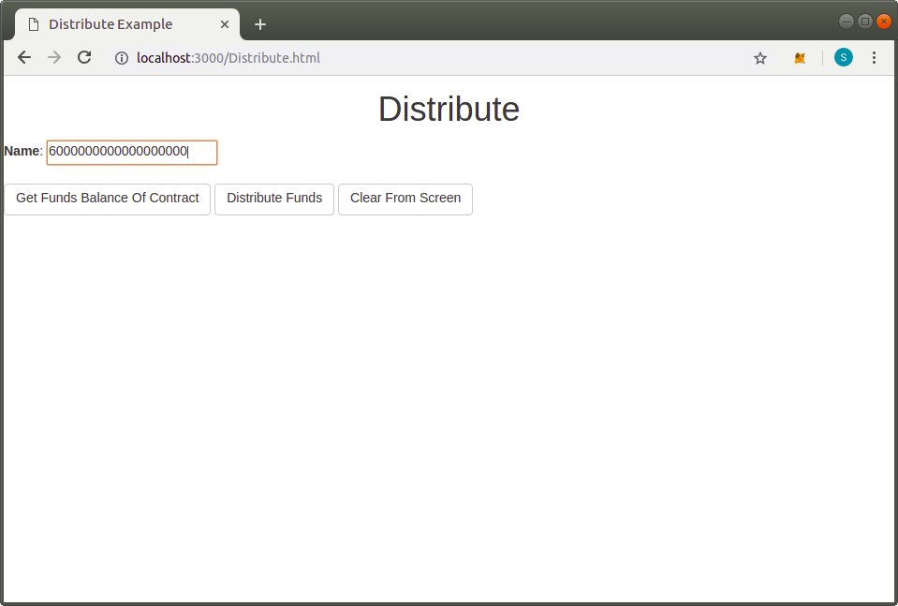
Distribute Example – Fetch Balance

Slide 49
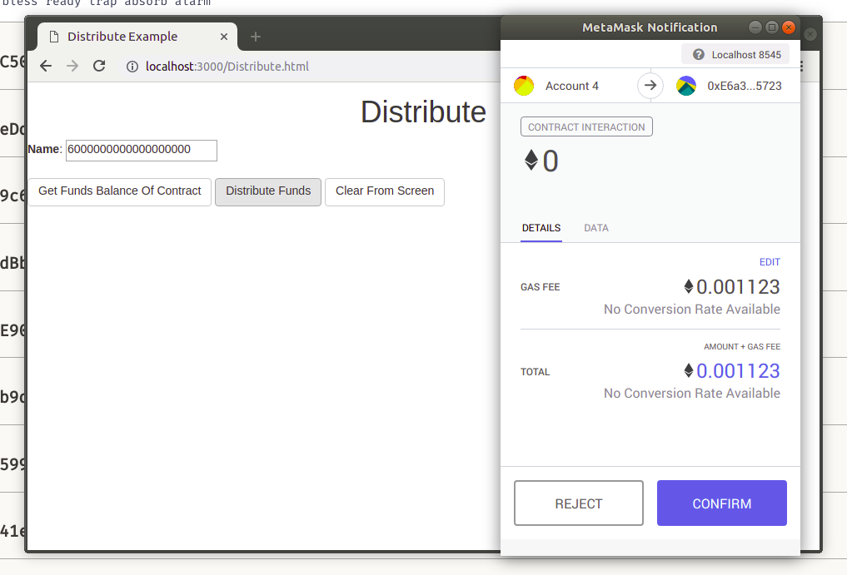
Distribute Example

Slide 50
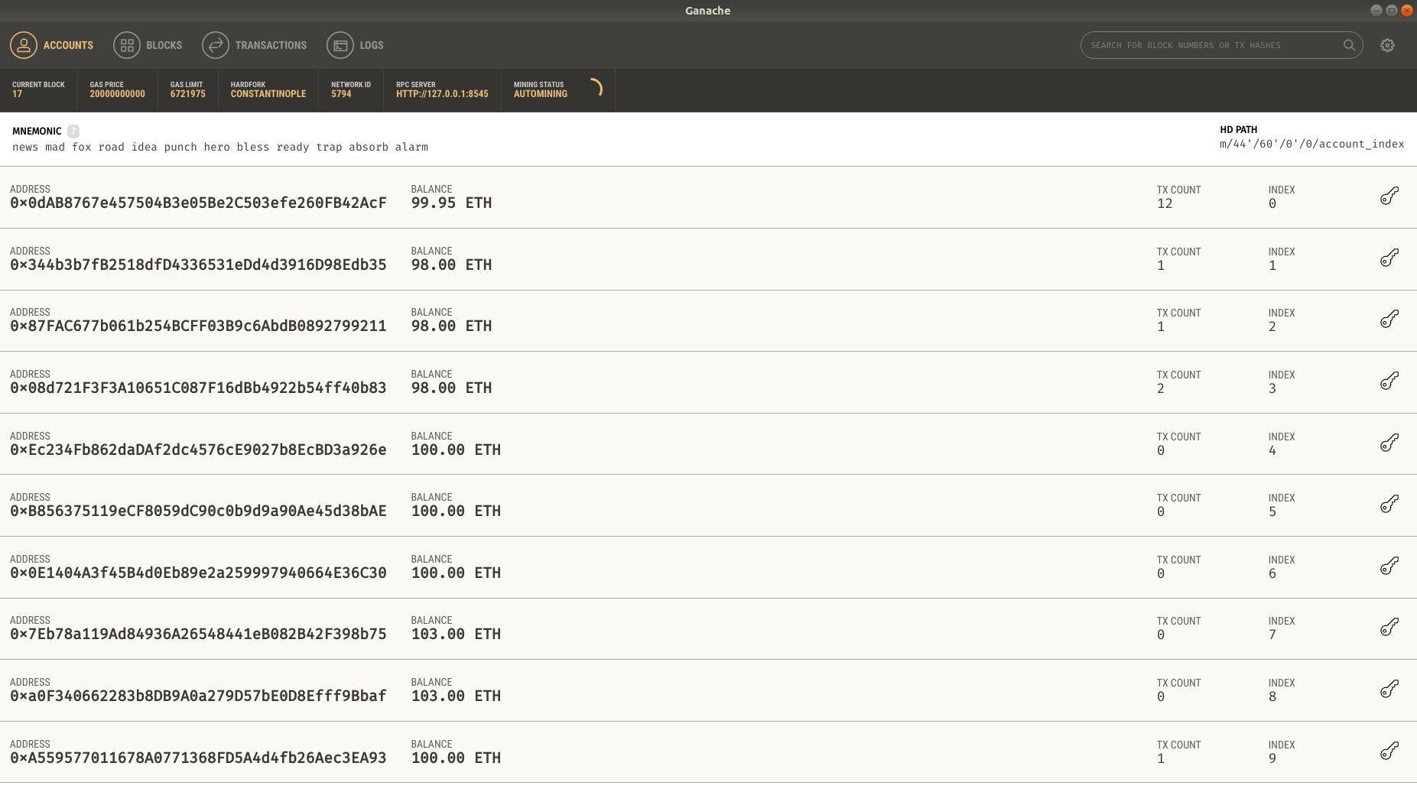
Distribute Example

Slide 51
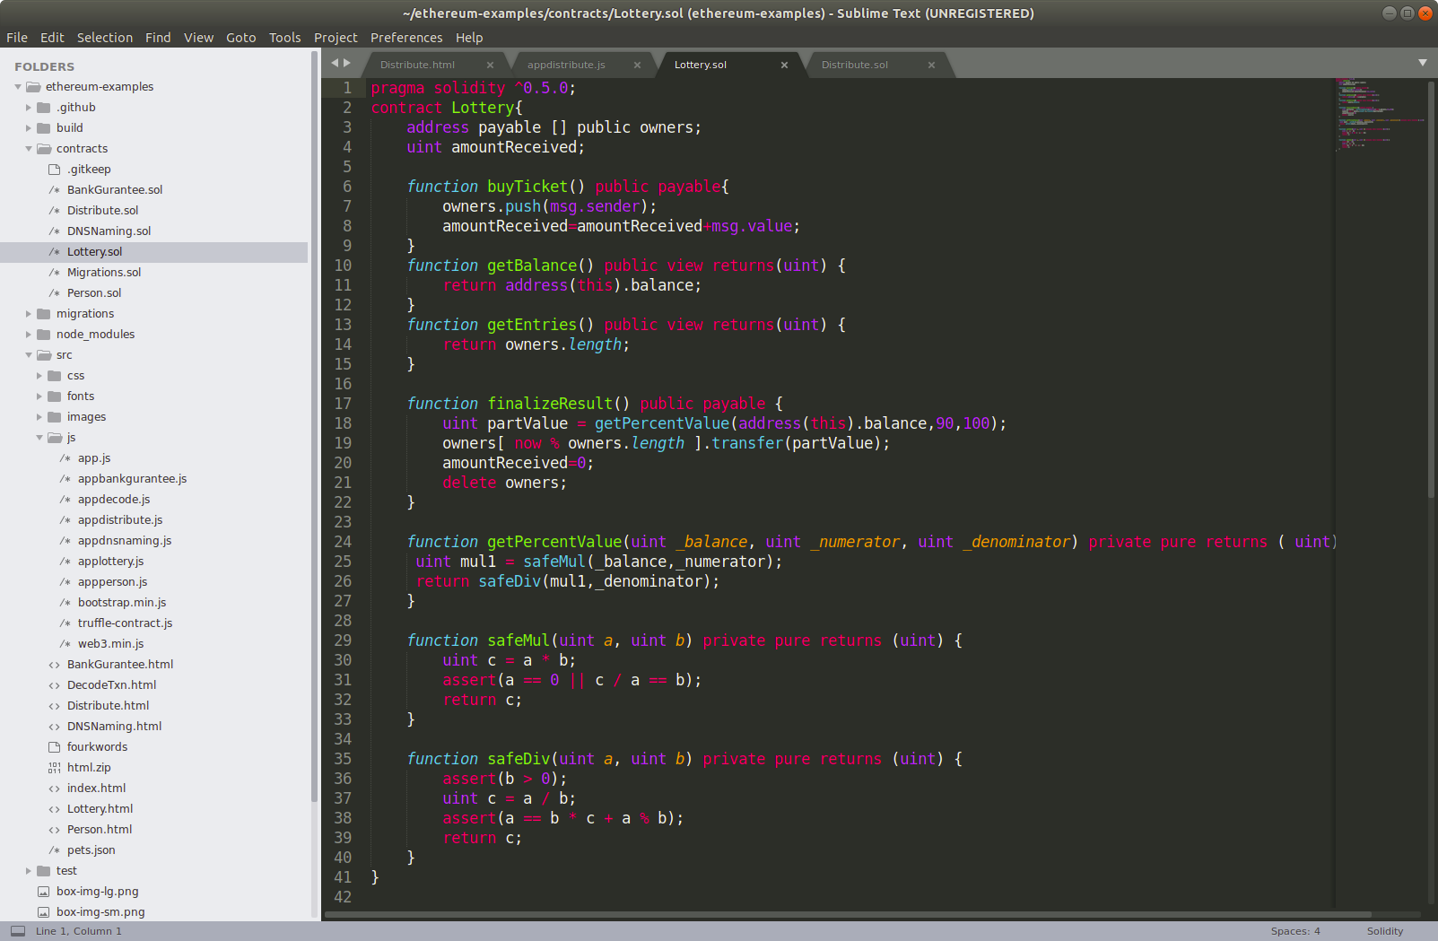
Lottery Example - Contract

Slide 52
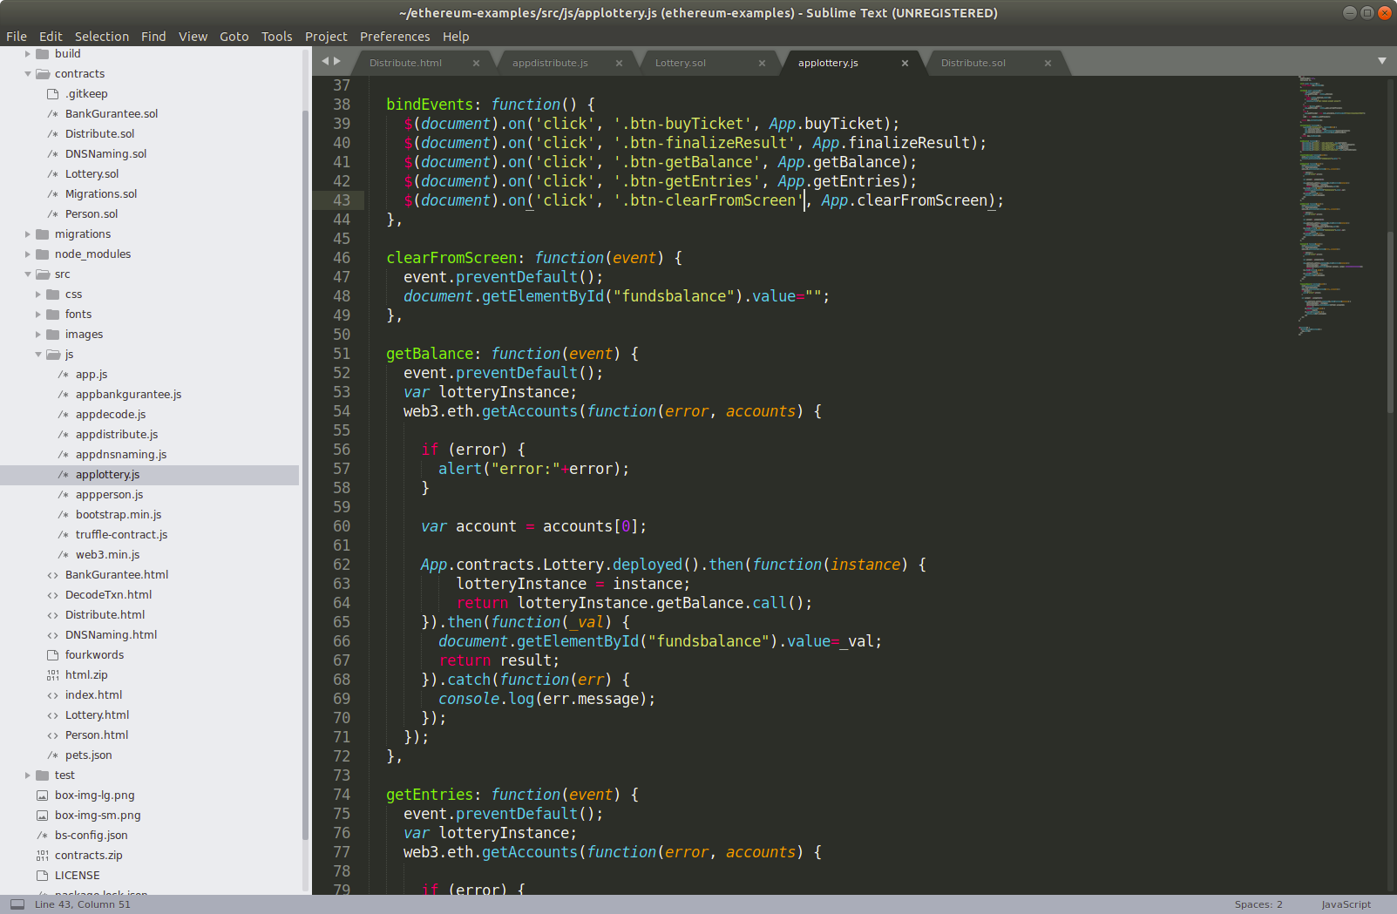
Lottery Example - JS

Slide 53
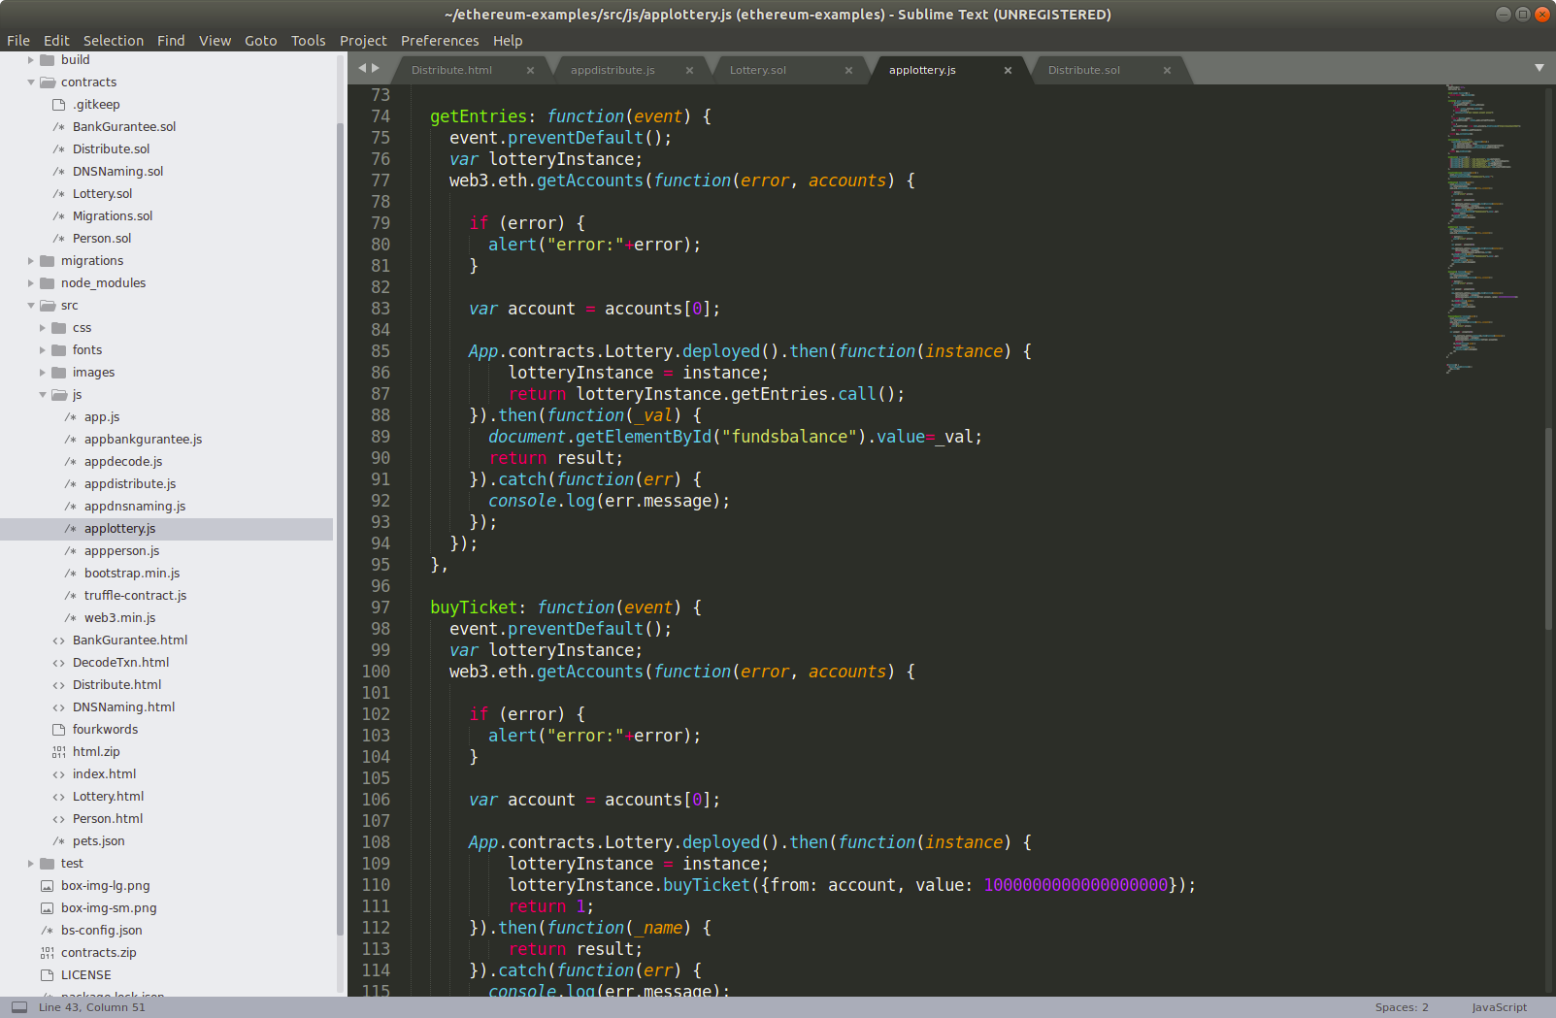
Lottery Example - JS

Slide 54
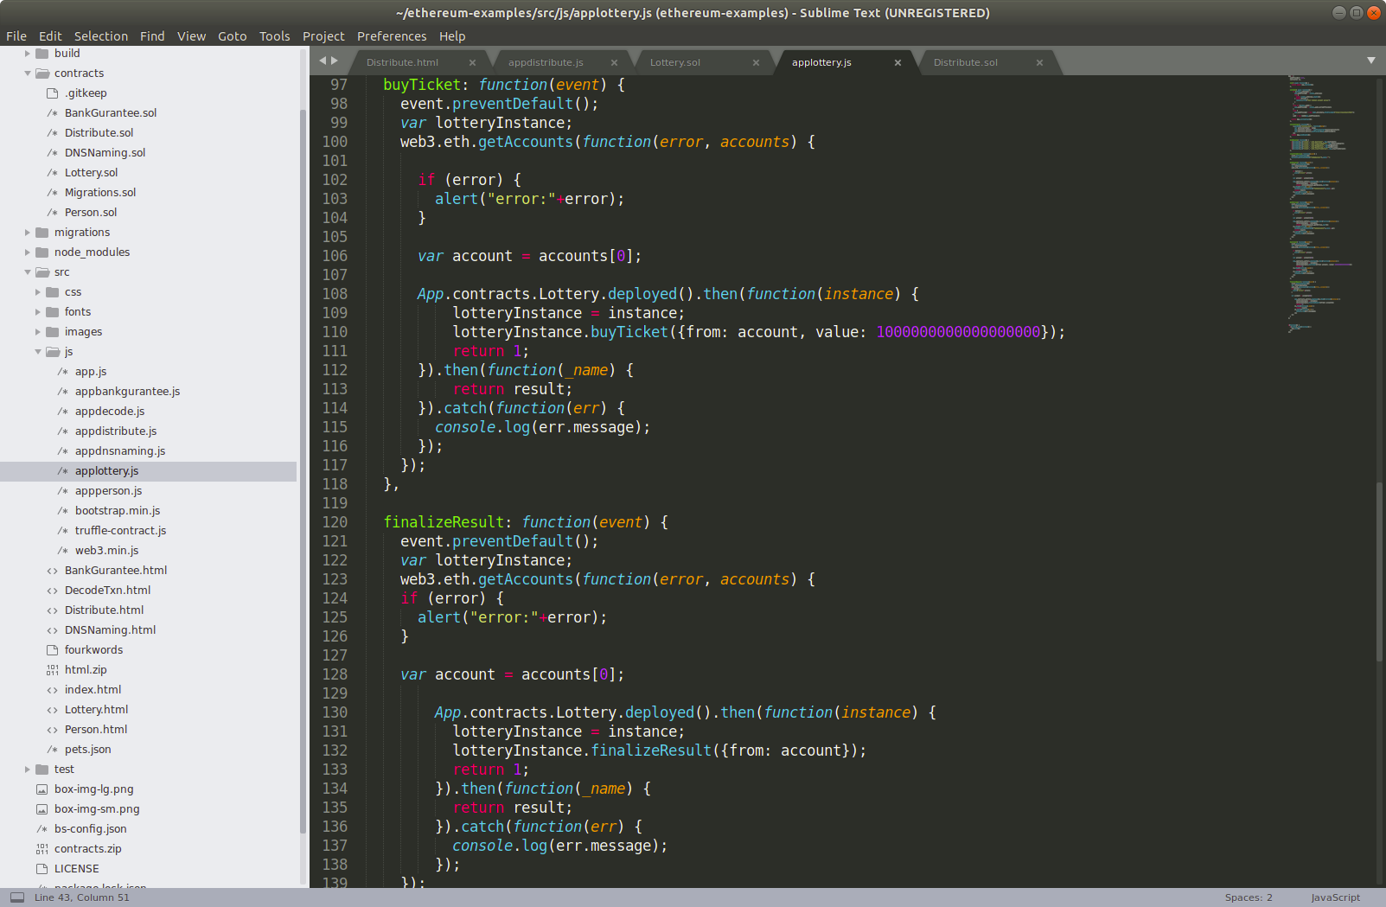
Lottery Example - JS

Slide 55
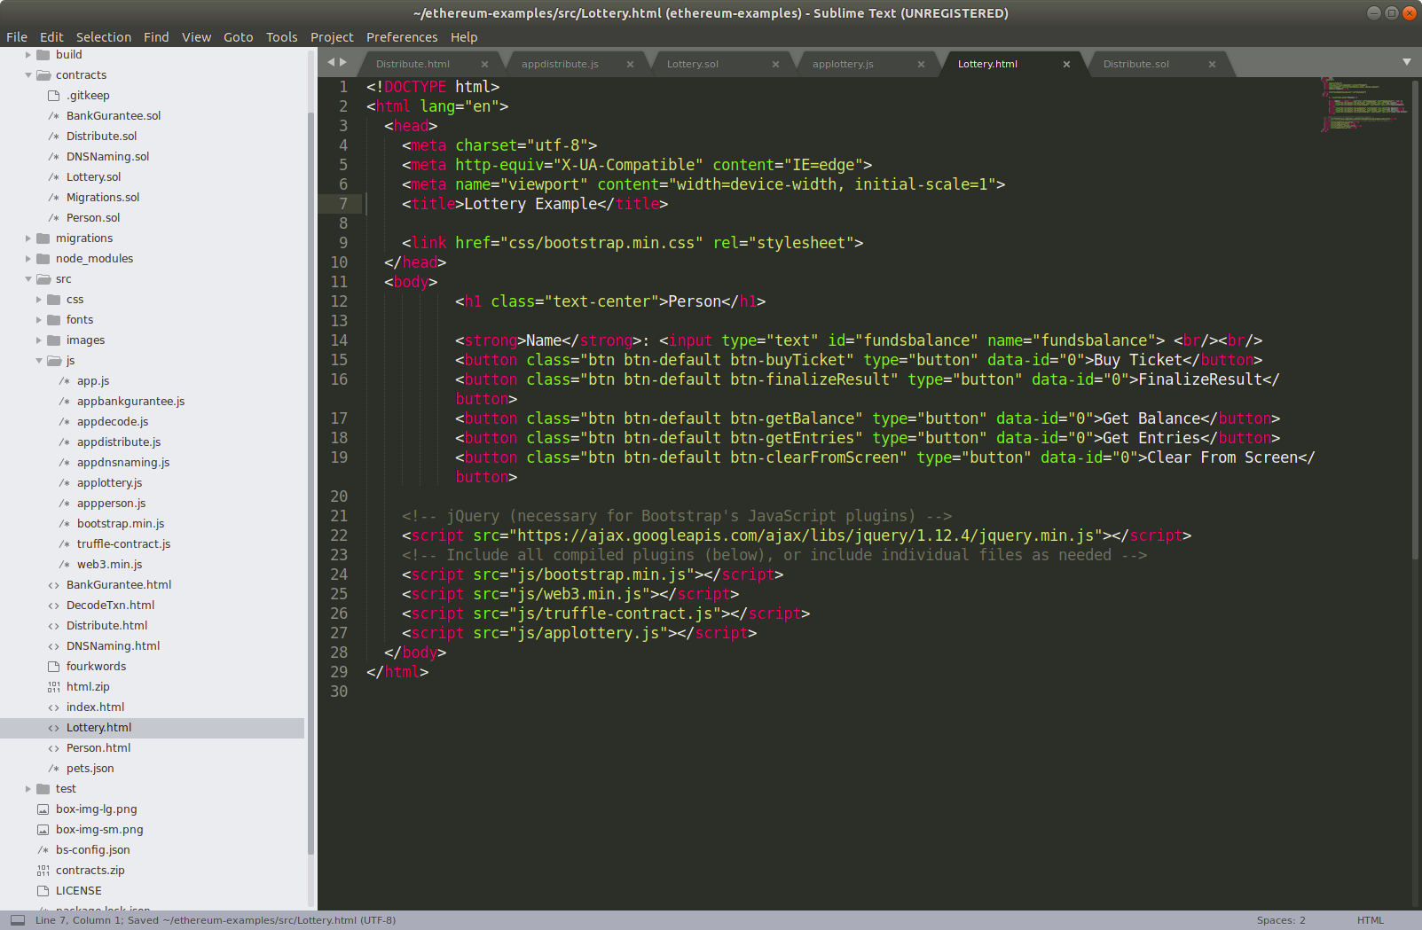
Lottery Example - HTML

Slide 56
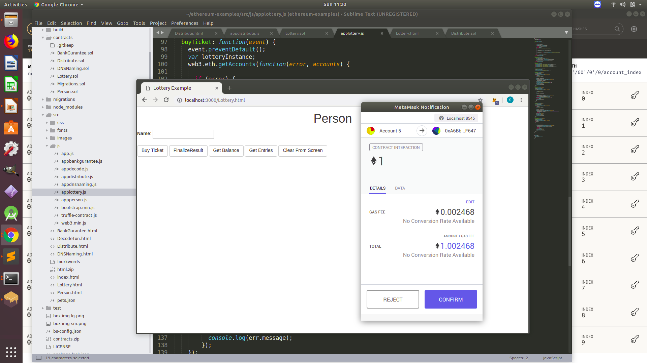
Lottery Example - Buy Ticket

Slide 57
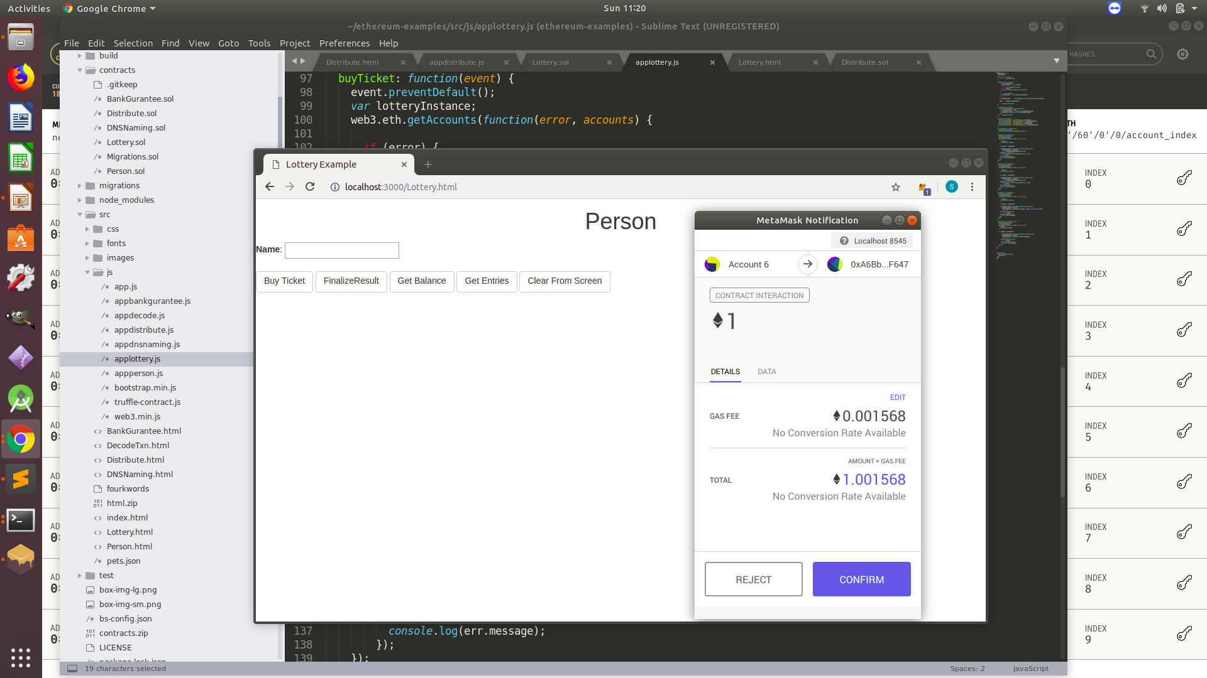
Lottery Example – Buy Ticket

Slide 58
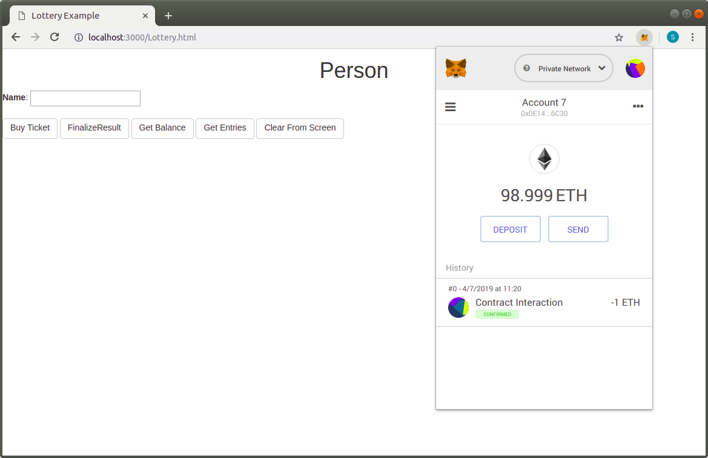
Lottery Example – Buy Ticket

Slide 59
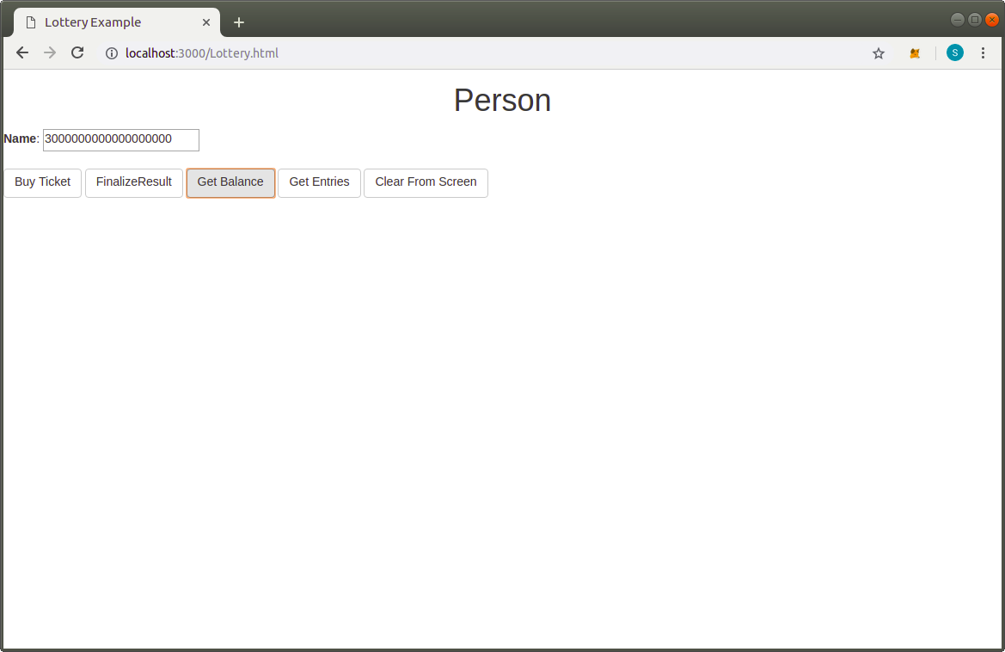
Lottery Example – Get Balance

Slide 60
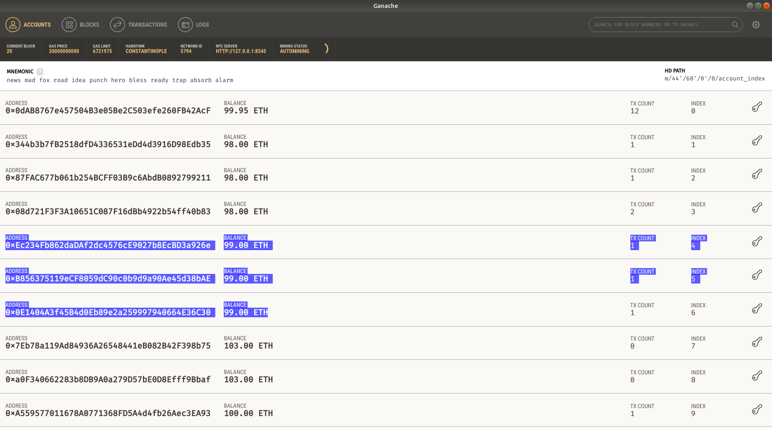
Lottery Example – Current Balances

Slide 61
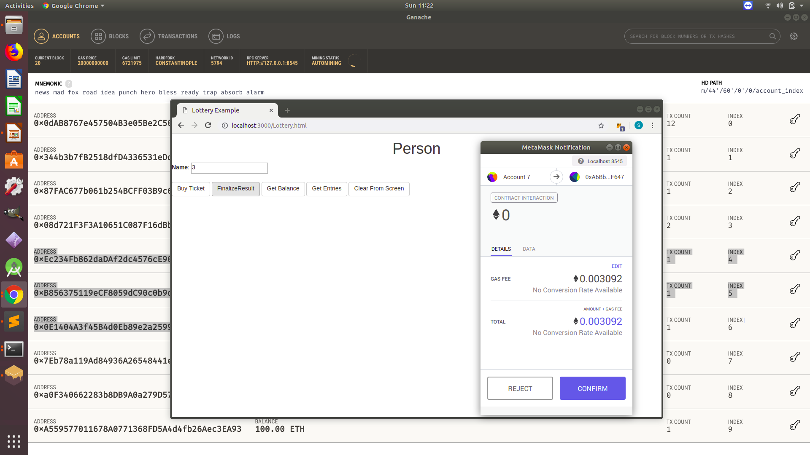
Lottery Example – Finalise Results

Slide 62

Lottery Example – Balances after Results

Slide 63

DNS Name Example –Contract

Slide 64

DNS Name Example – JS

Slide 65

DNS Name Example – JS

Slide 66

DNS Name Example – HTML

Slide 67

DNS Name Example – Buy DNS Name

Slide 68

DNS Name Example – Buy DNS

Slide 69

DNS Name Example – Get Subscription

Slide 70

Bank Gurantee Example – Contract

Slide 71

Bank Gurantee Example – JS

Slide 72

Bank Gurantee Example – JS

Slide 73

Bank Gurantee Example – JS

Slide 74

Bank Gurantee Example – JS

Slide 75

Bank Gurantee Example – HTML

Slide 76

Bank Gurantee Example – Set Exporter

Slide 77

Bank Gurantee Example – Set Importer

Slide 78

Bank Gurantee Example – Initiate Payment

Slide 79

Bank Gurantee Example – Amt transfered to Contract

Slide 80

Bank Gurantee Example – Disburse Payment

Slide 81

Bank Gurantee Example – After Disburse Payment

Slide 82
Thank you

